Slide 1

ONSTR The Ontology for Newborn Screening Follow-up and Translational Research
Snezana Nikolic, Prabhu Shankar, Sivaram Arabandi,
Akshaye Dhawan, Rajshekhar Sunderraman, Sham Navathe,
Kunal Malhotra, Rani H. Singh
ICBO 2013, Semantic Trilogy, Montréal, QC

Slide 2
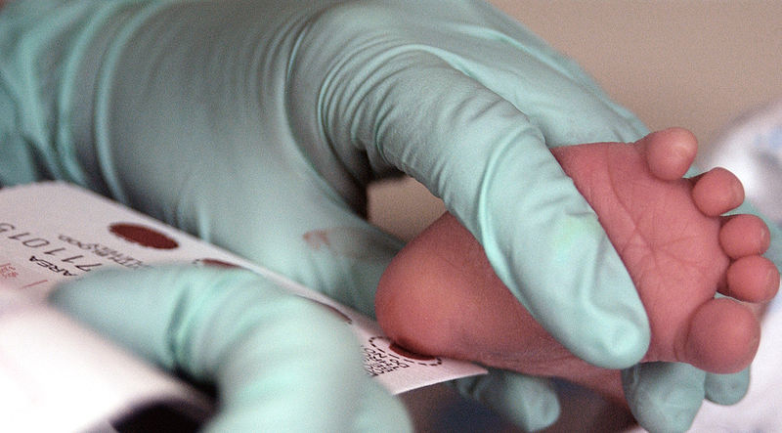
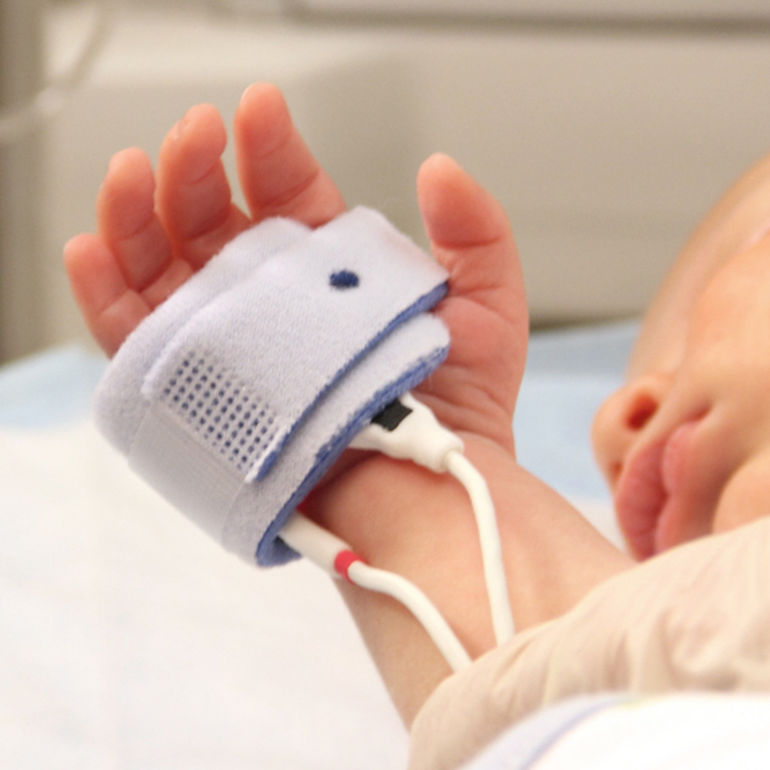
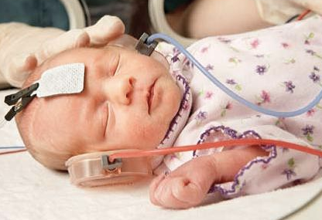
NewBorn Screening System
1. Newborn Screening Proper (NBS): Detection (57 diseases)
Dried Blood Spot
Screening
Point-of-Care
Screening
46 Inherited Metabolic Diseases (IMDs/IEMs)
Cystic Fibrosis
Primary Congenital Hypothyroidism
Haemoglobinopathies
Congenital Adrenal Hyperplasia
Severe Combined Immunodeficiencies
Pulse oxymetry
CCHD
Hearing screening
55 Diseases
+!
2. Short-term Follow-up (STFU): Confirmatory testing
3. Long-term Follow-up (LTFU)
Life-long treatment & intervention (nutritional and/or medical)
Growth and development monitoring, Treatment improvement
+!

Slide 3
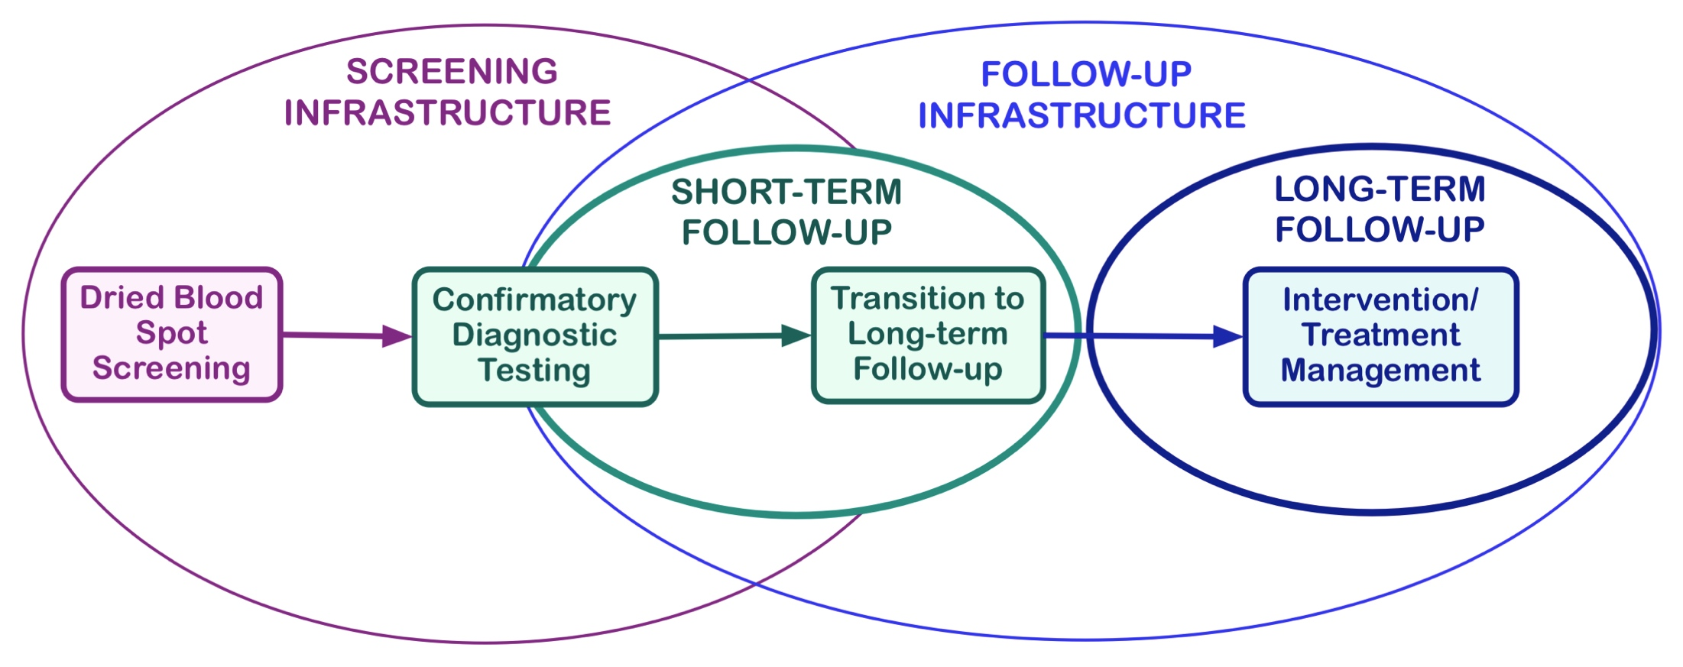
The Data
Screening Data
DBS screening results
Gestational age
Birth weight/height
STFU Data
Confirmatory test results
Genetic mutation info
LTFU Data
Dietary intakes
Metabolite concentrations
Full blood count
Anthropometric measurements
Body composition, Bone density
Imaging data (MRI, EEG, CT, Xray)
Psycho-cognitive-motor assessments
Clinical history, Neurotransmitter levels
• Continuous Quality Improvement of Patient Treatment and Outcome
• Translational Research (Generates more data)
• New Knowledge Generation and Meaningful Use

Slide 4
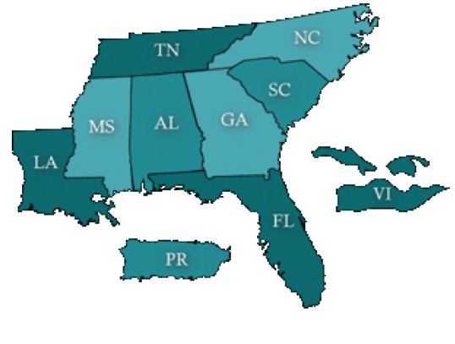



The Data = Challenge
1. Small number of patients with particular IMD
2. Patient data stored locally and in various formats
US SOUTHEAST
REGION
SAMPLE SIZE and
RESEARCH VALIDITY PROBLEM
3
4
3
3
1
5
2
0
SOULTION = DATA INTEGRATION
0
6
backed by

Slide 5
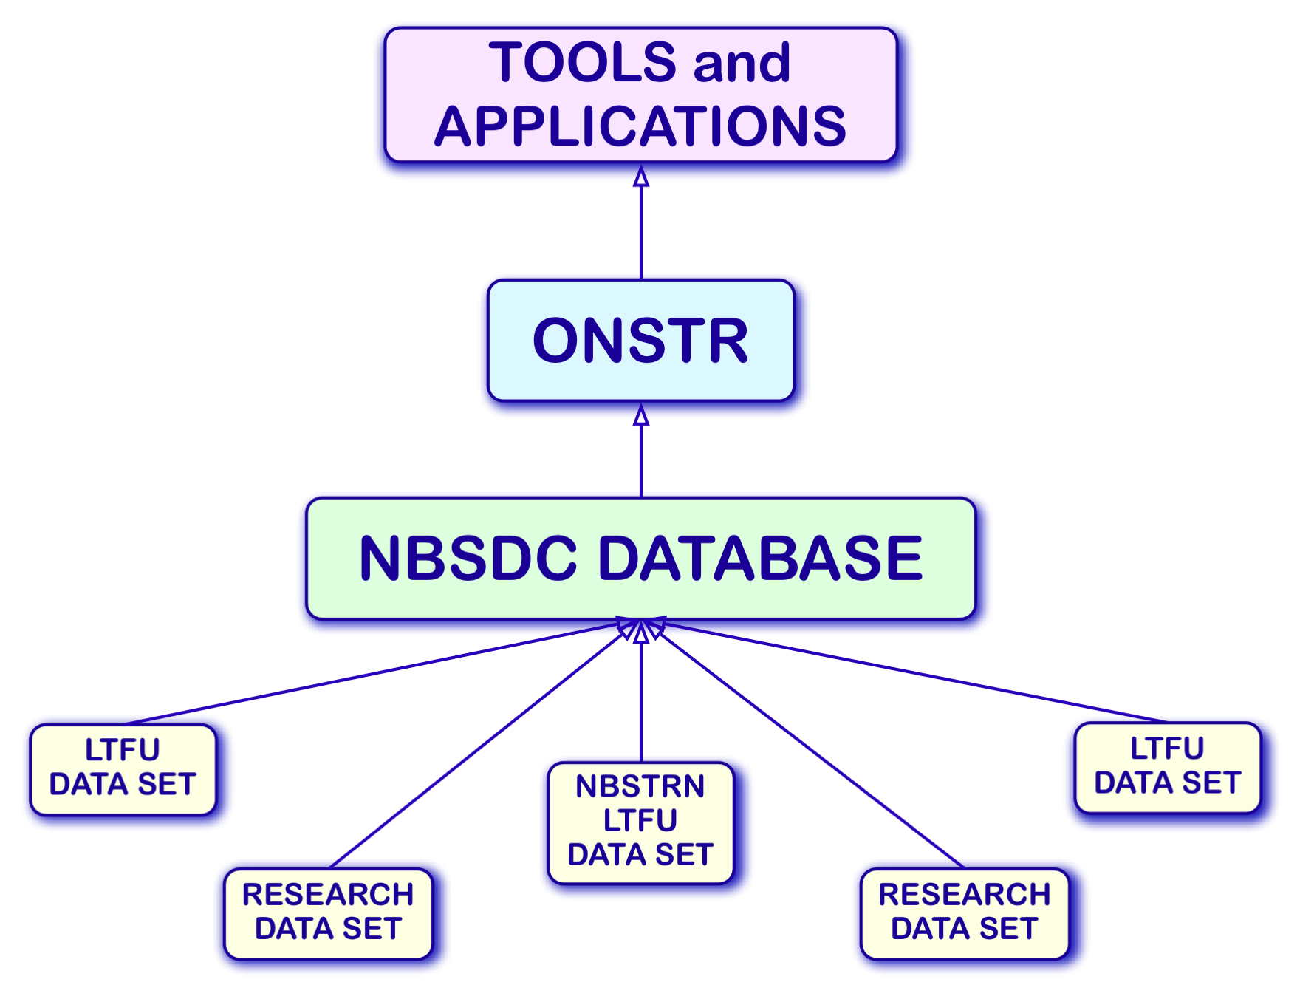
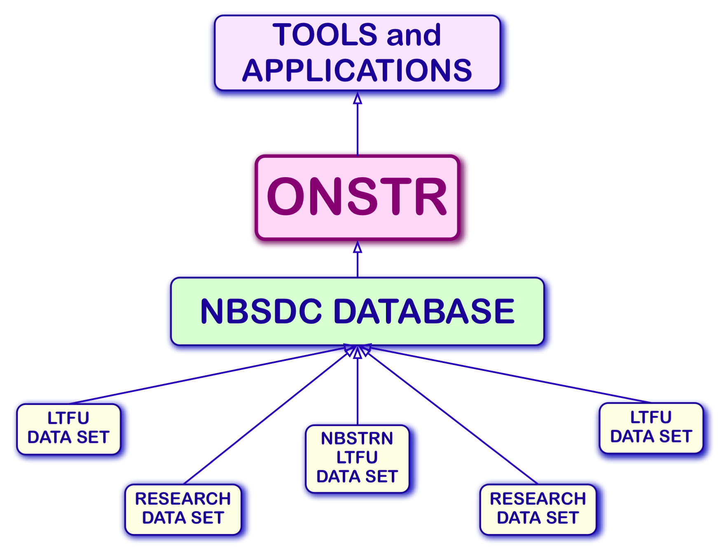
Our Solution: The Newborn Screening Follow-up Data Integration Collaborative
https://nbsdc.org

Slide 6

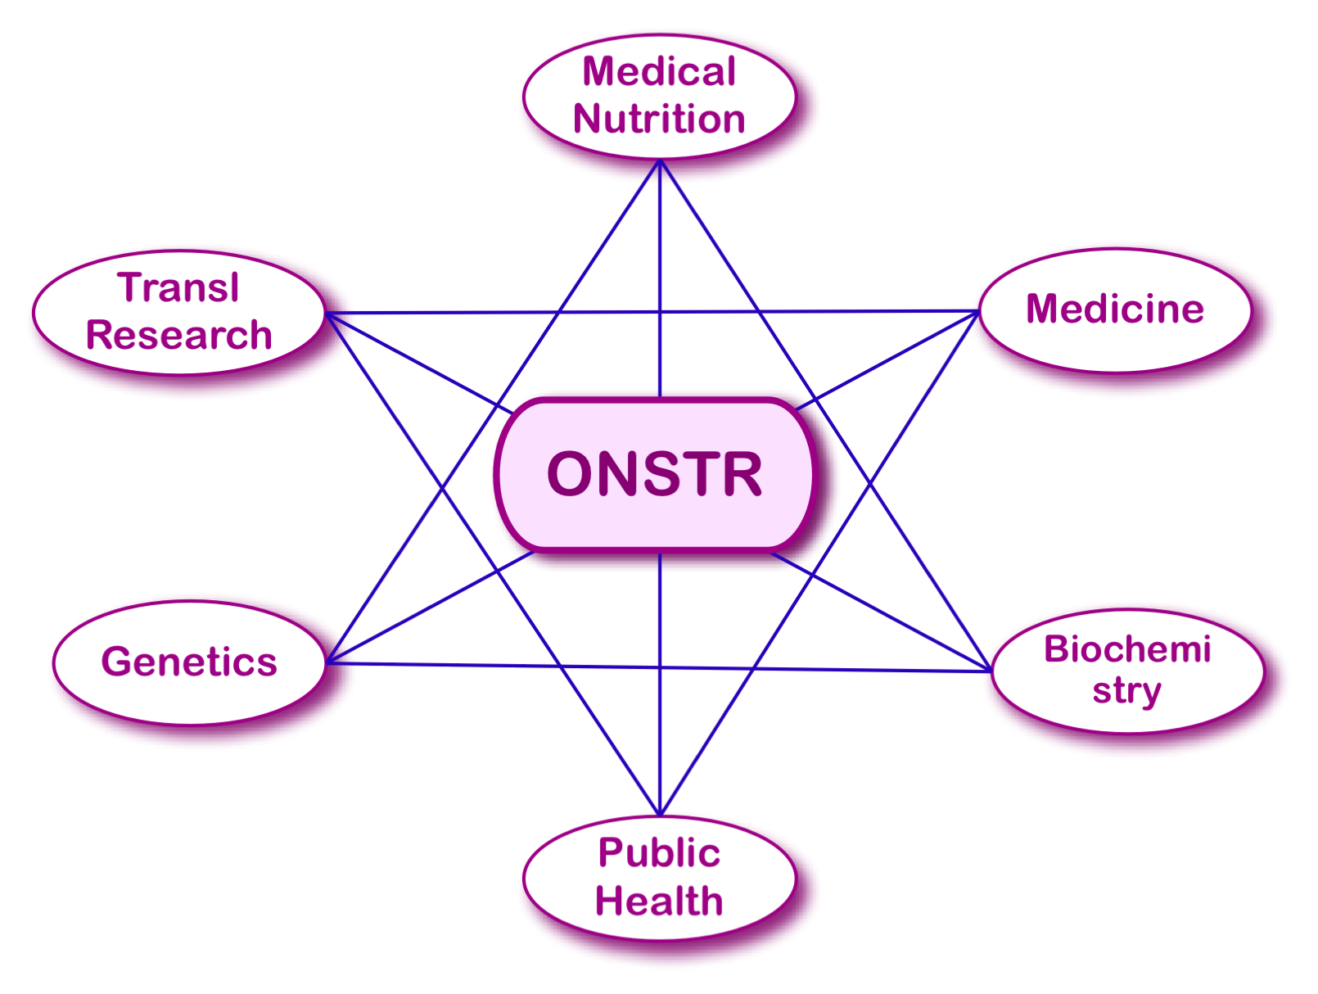

The Ontology for Newborn Screening Follow-up and Translational Research
 Application ontology (currently 1852 classes)
 Built by following
 Top-down bottom-up methodology
 OBO Foundry best practices:
BFO2
MIREOT (OBI, IAO, GO, PR, OGMS, ChEBI, PATO, CL, FMA...)
Aristotelian definitions
 Ontological realism
 Domain: Complex - Reflects the reality of NBS follow-up
 Data entities
 Processes
 Agents/Process participants

Slide 7
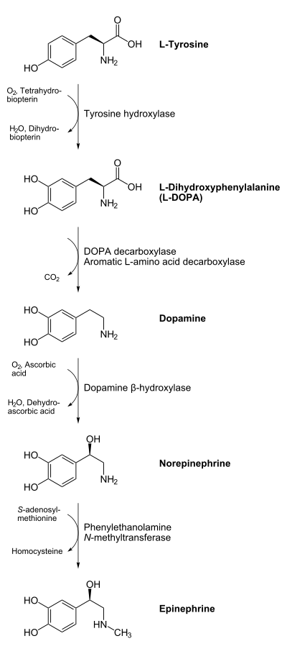
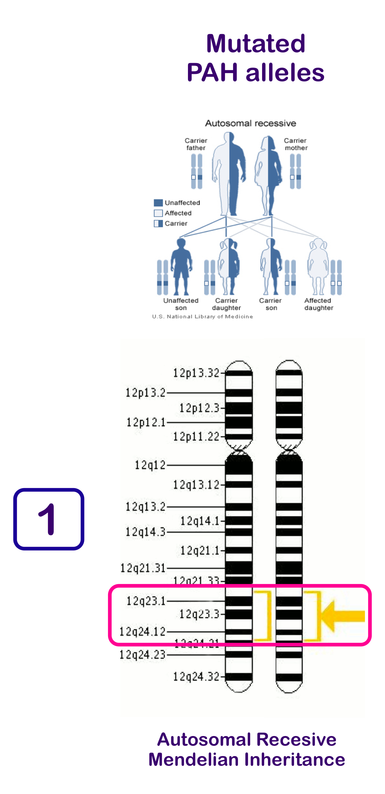
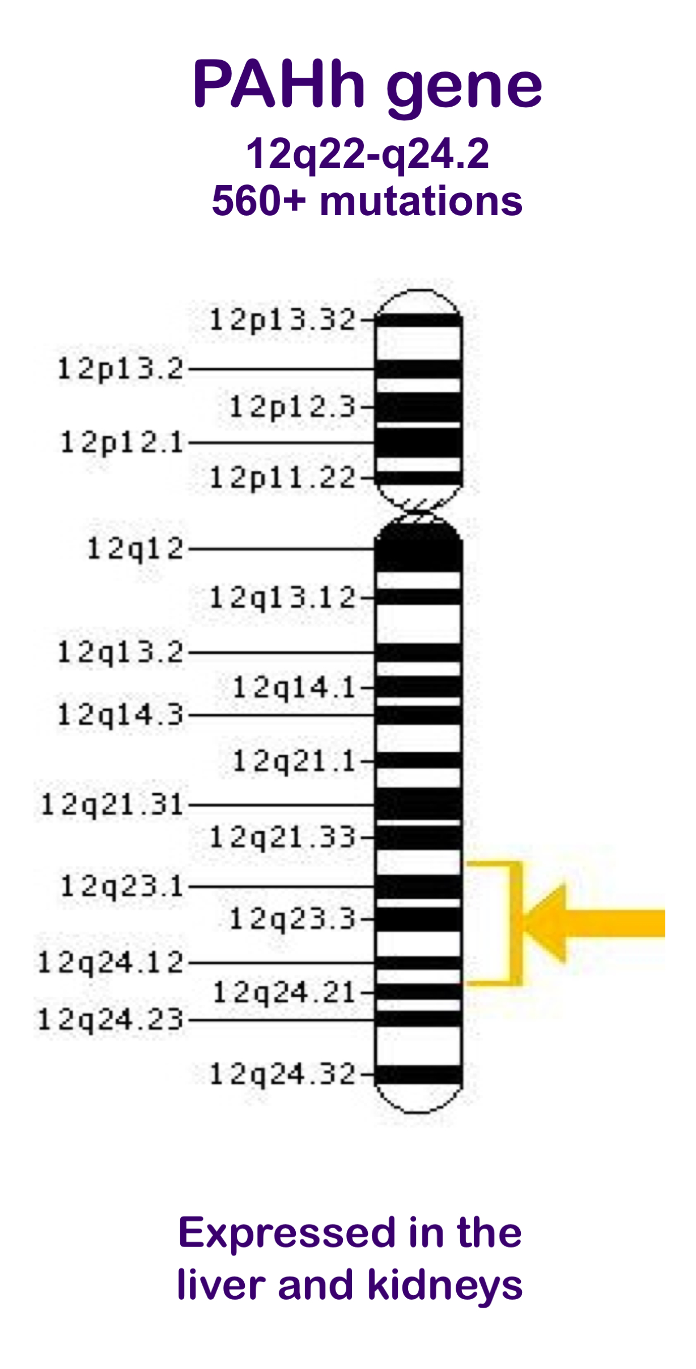
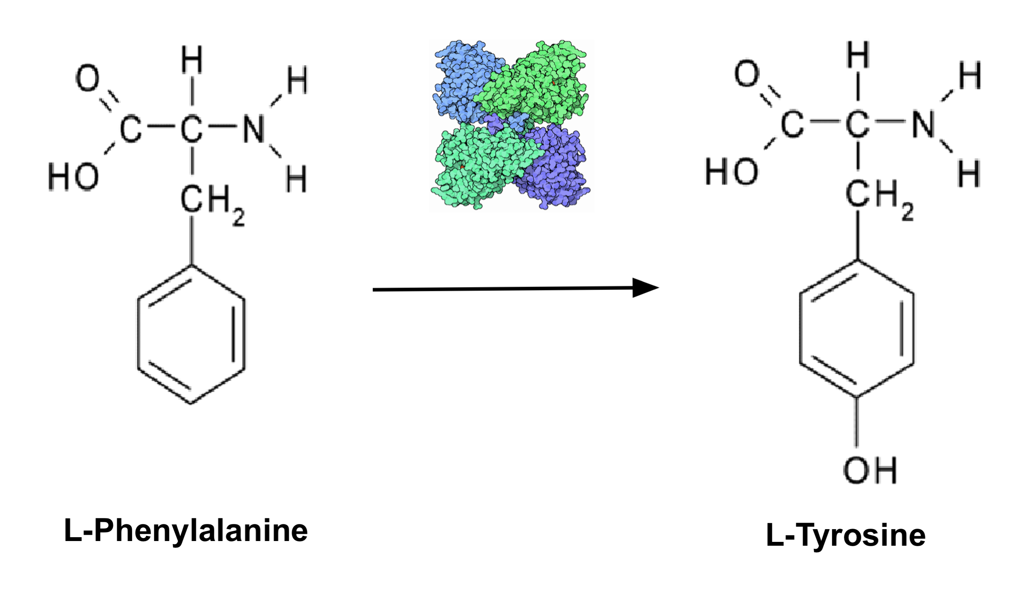
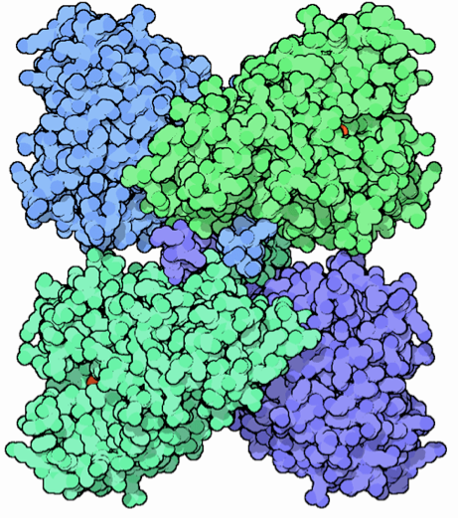
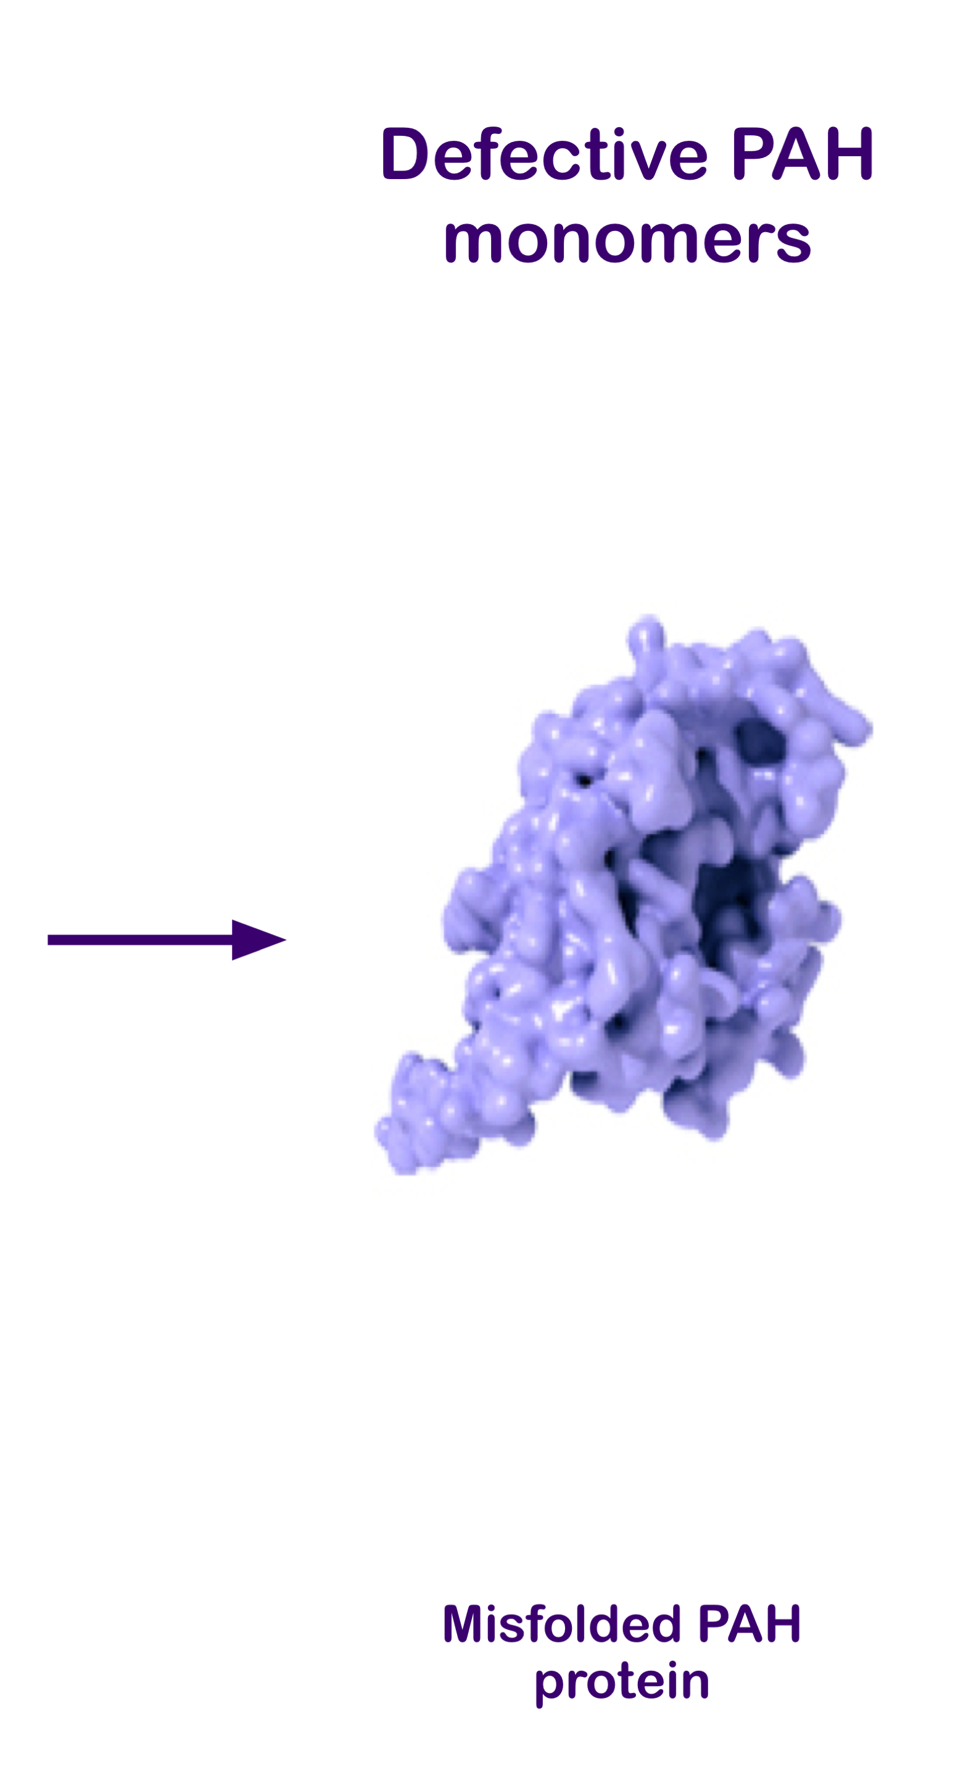
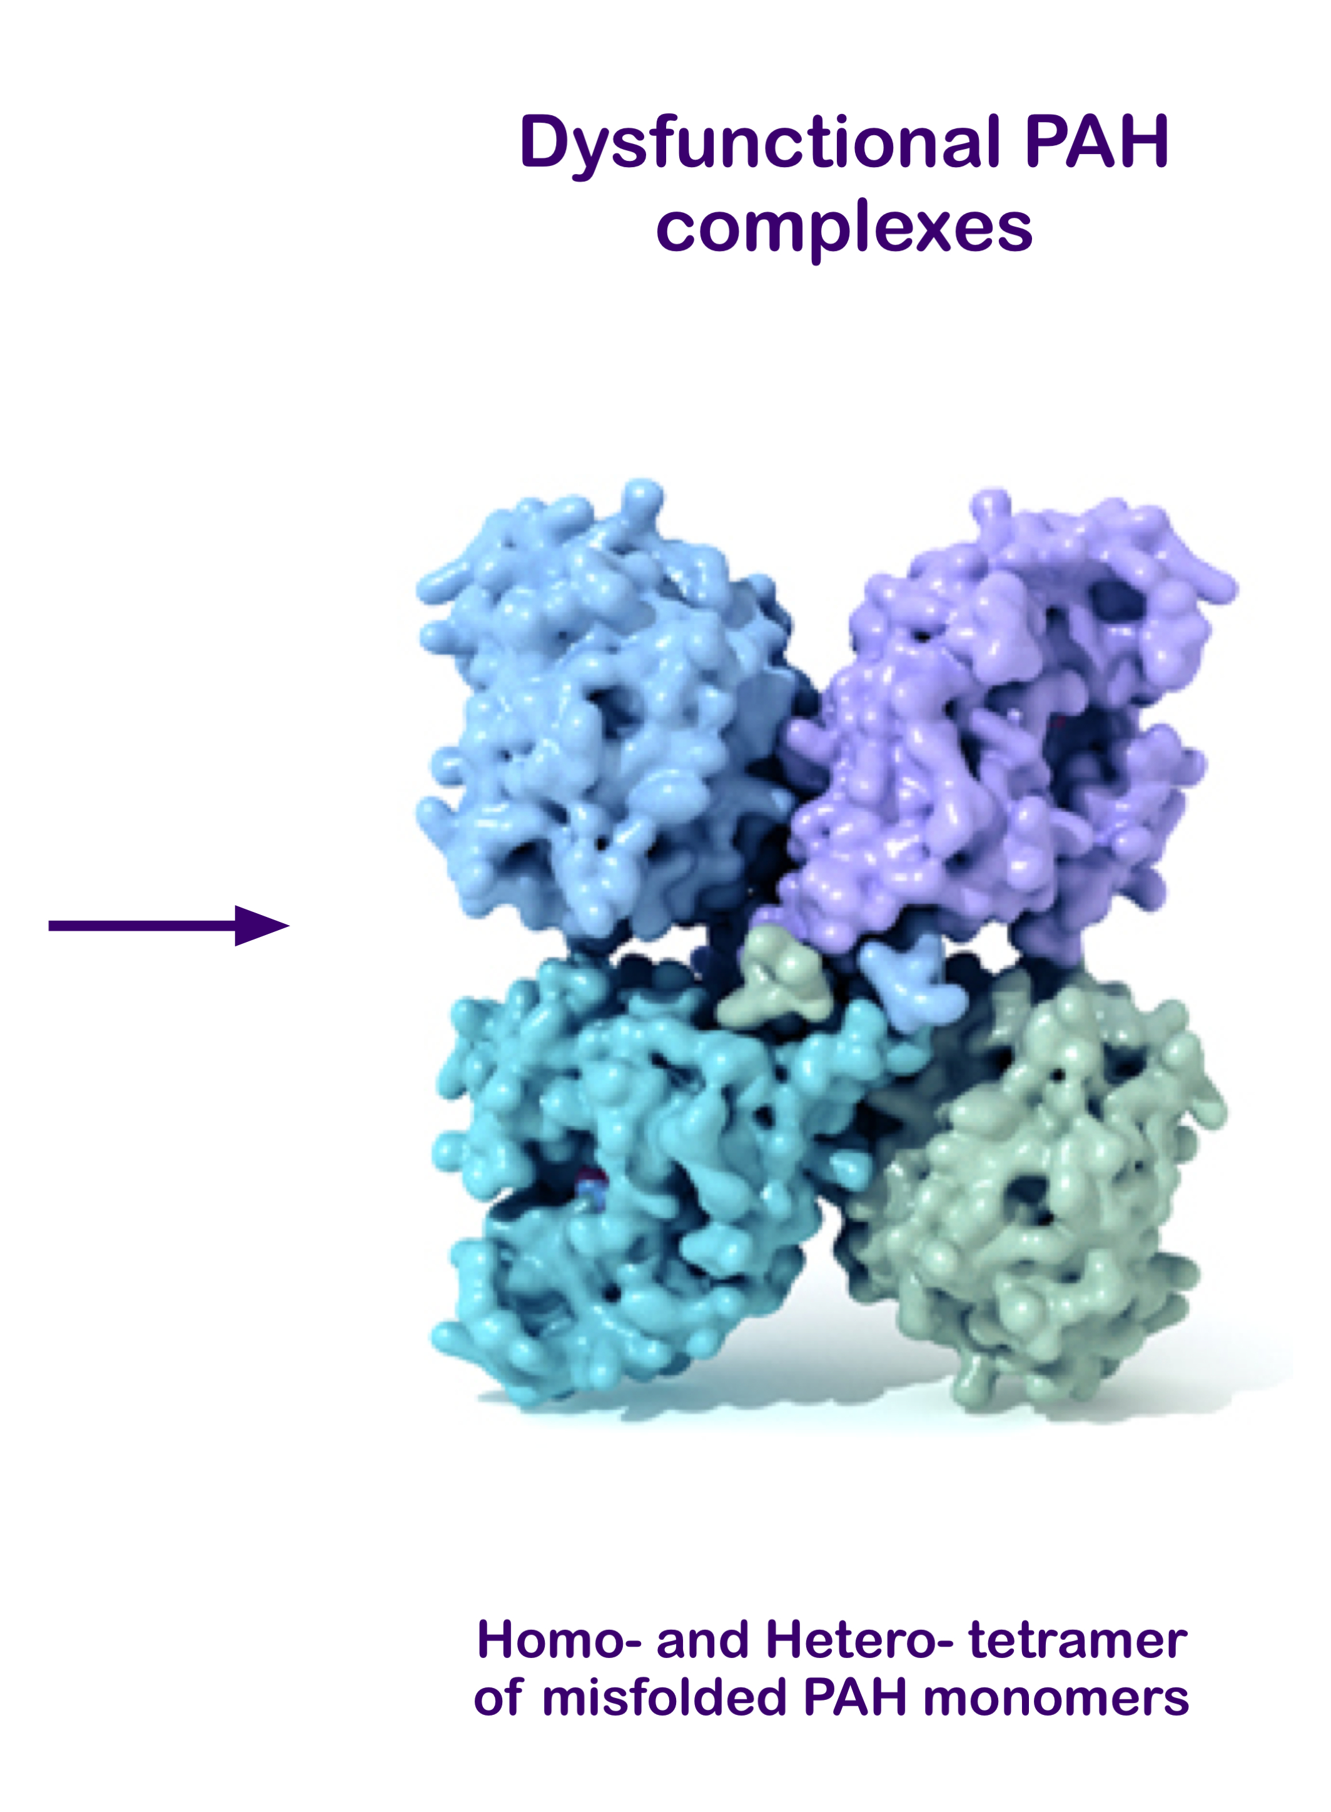
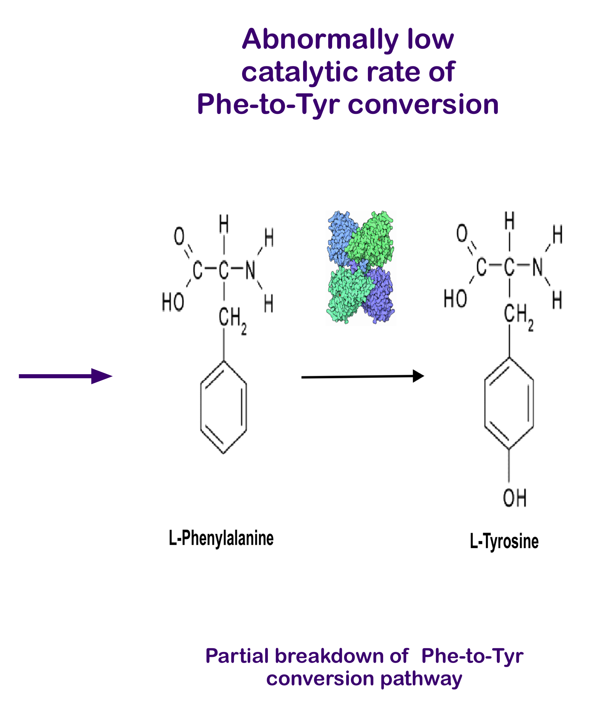
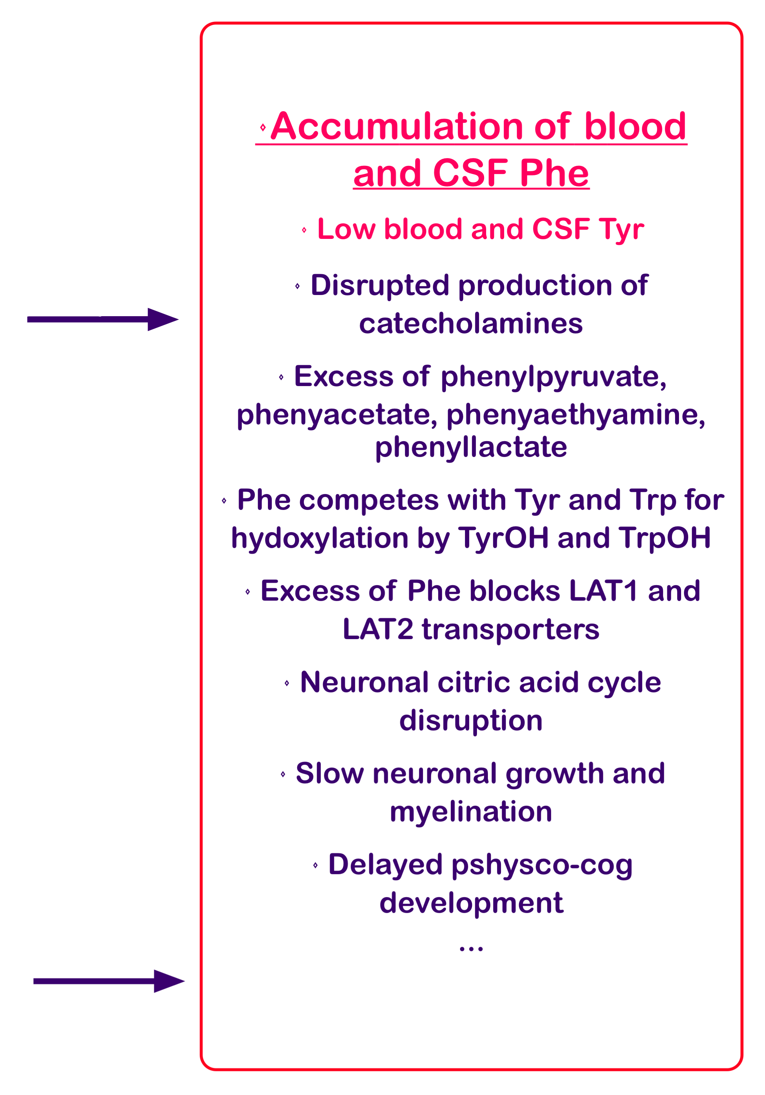
Etiology of HyperPhenylalaninemia (a.k.a PKU) (An example applicable to all IMDs)
PAH
EC1.14.16.1

Slide 8
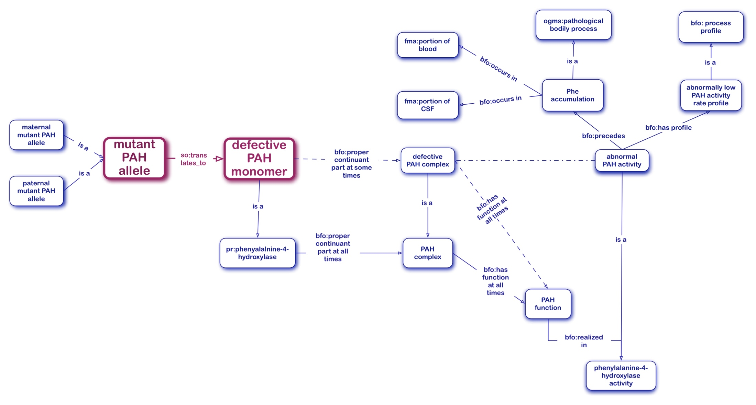
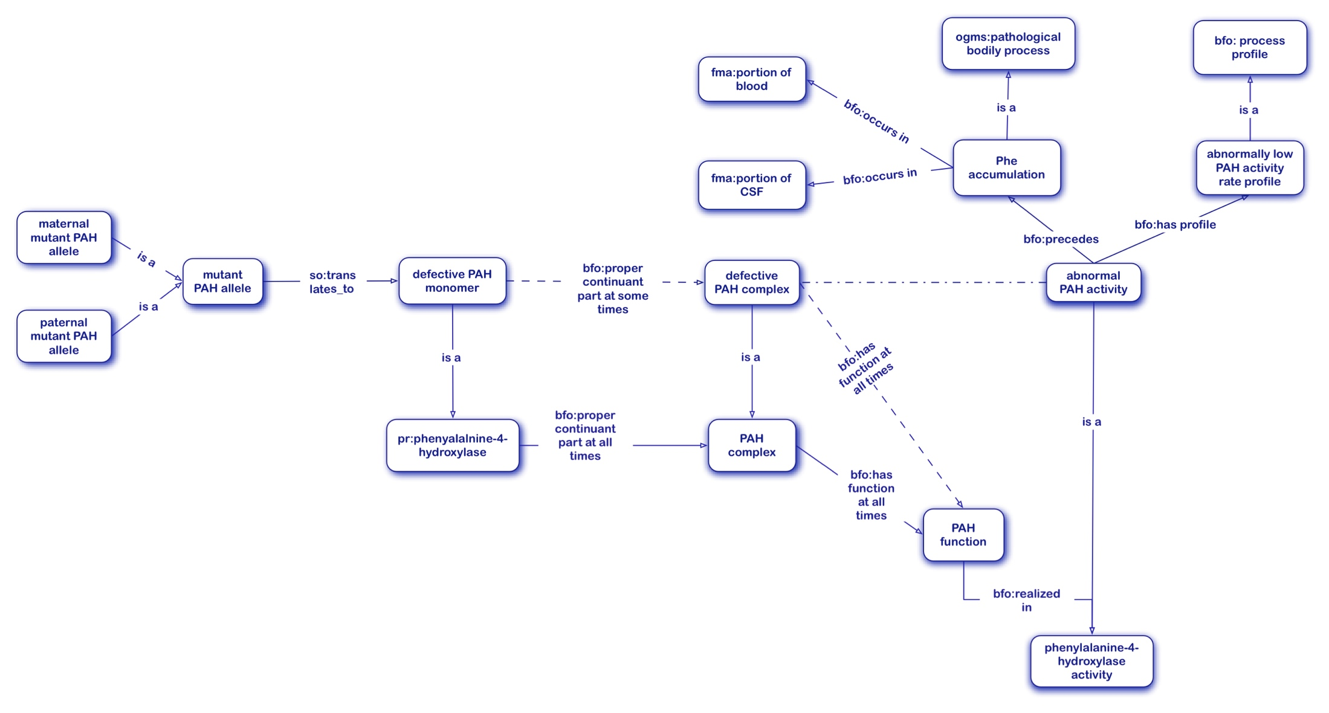
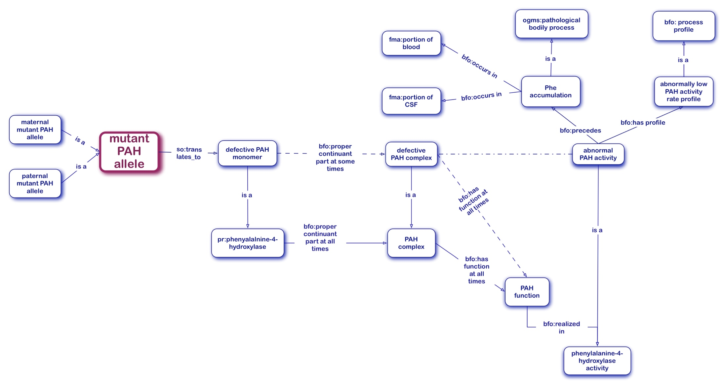
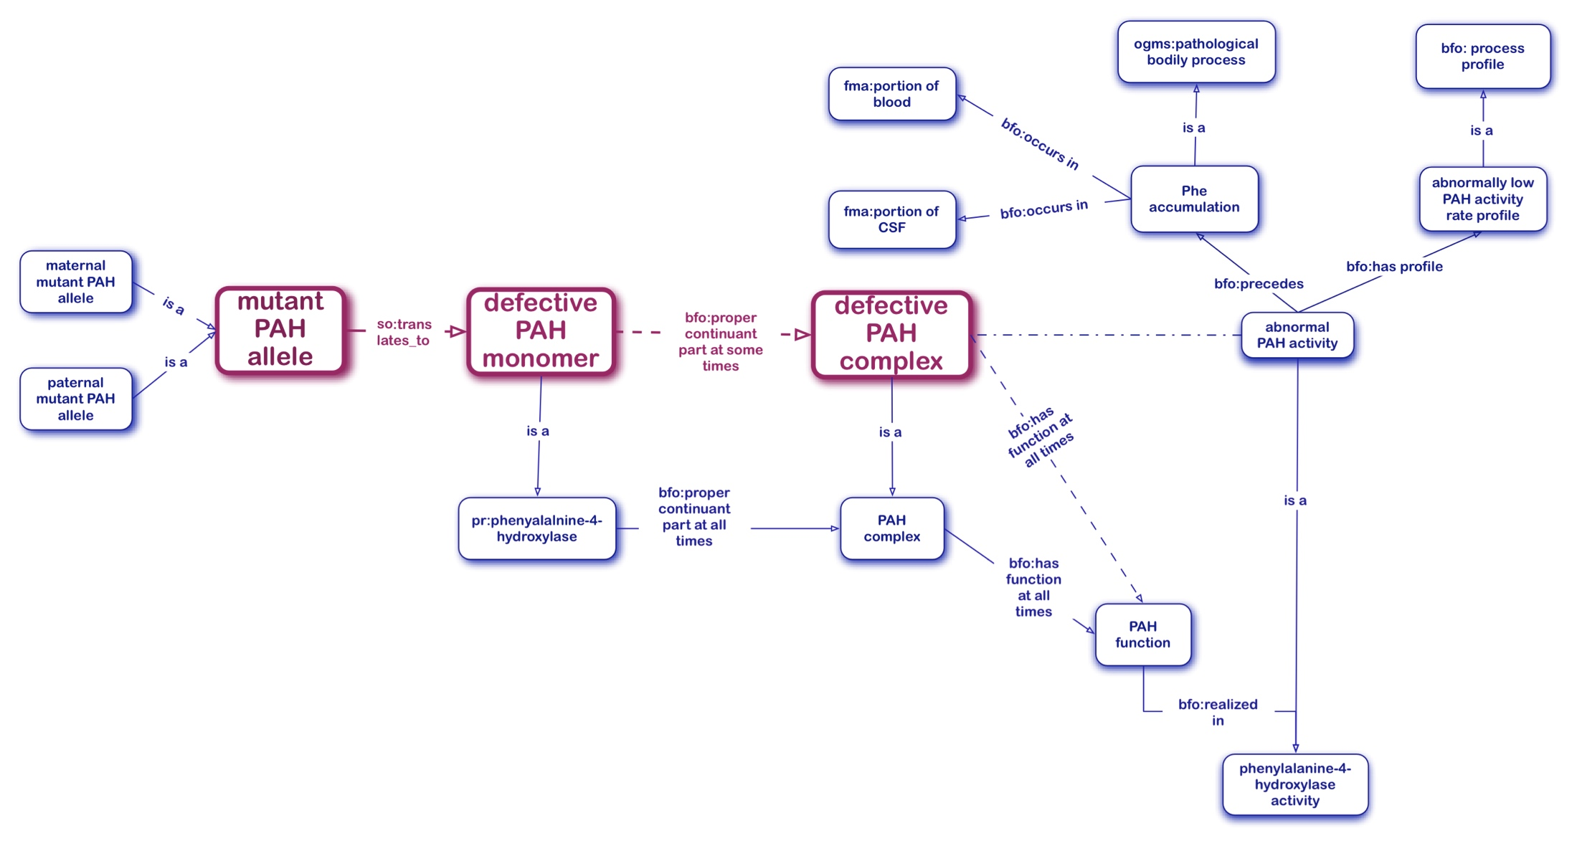
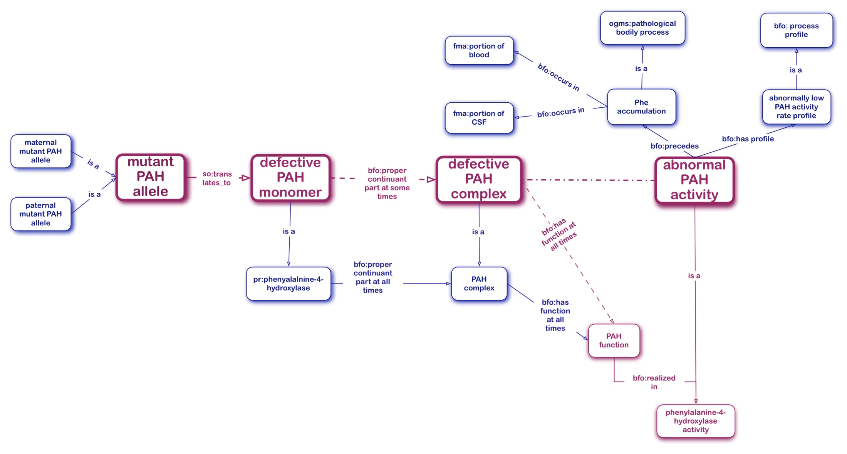
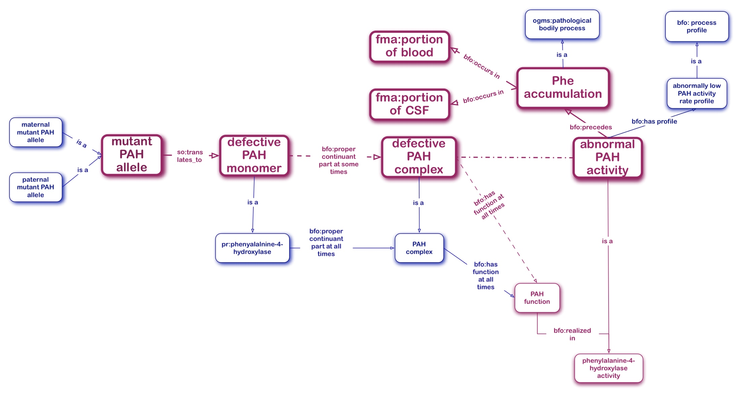
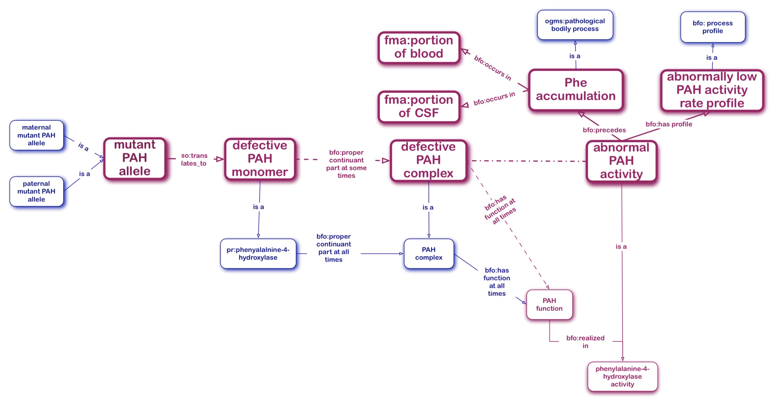
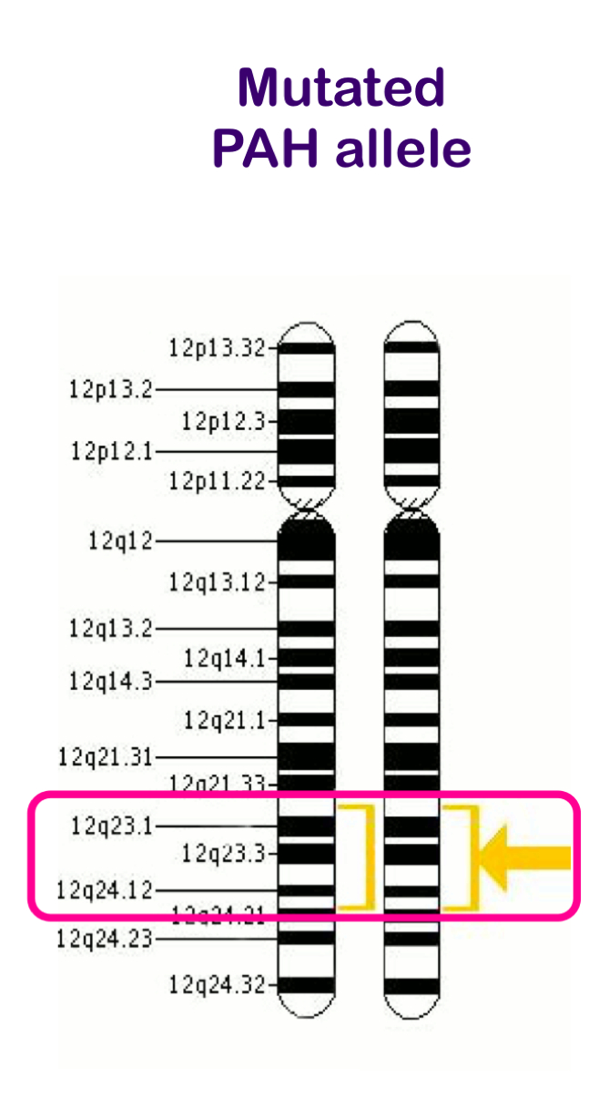
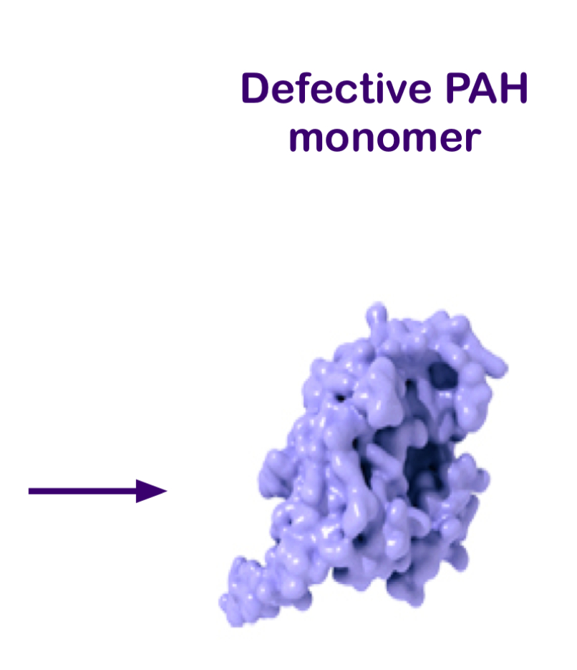
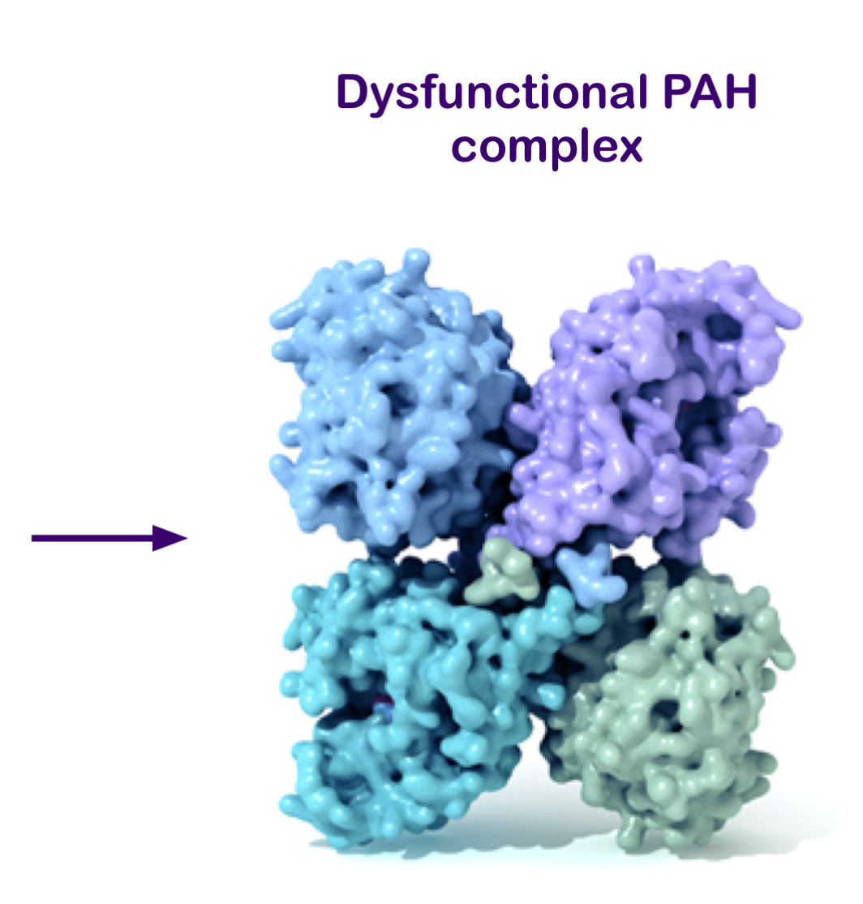
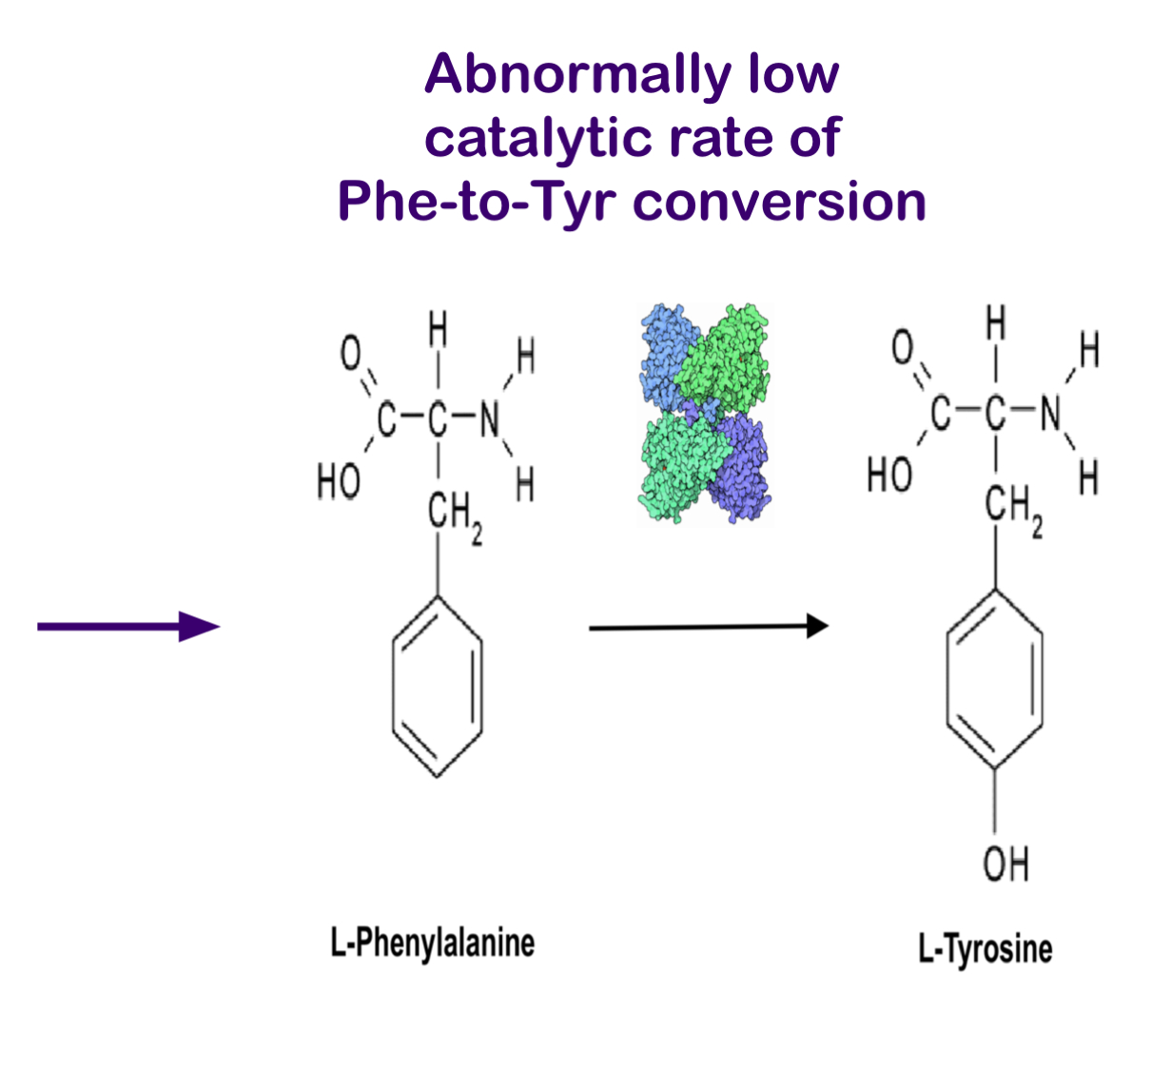
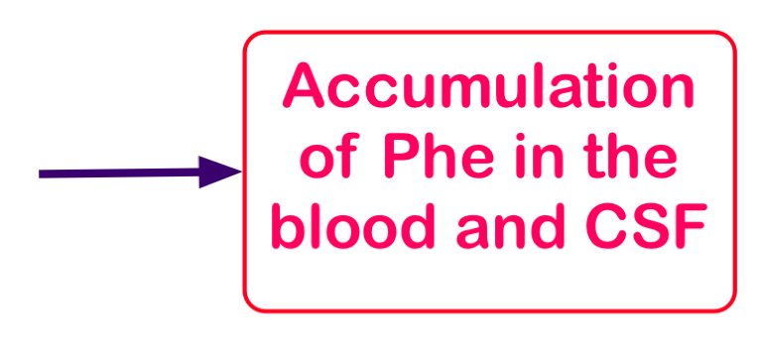
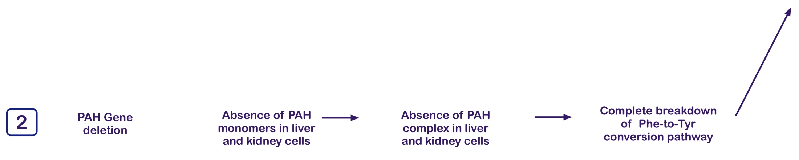
Ontological Model of the Etiology of Hyperphenylalaninemia (Applicable with modifications to all IMDs)
BFO2:
process profile
2 ?!

Slide 9
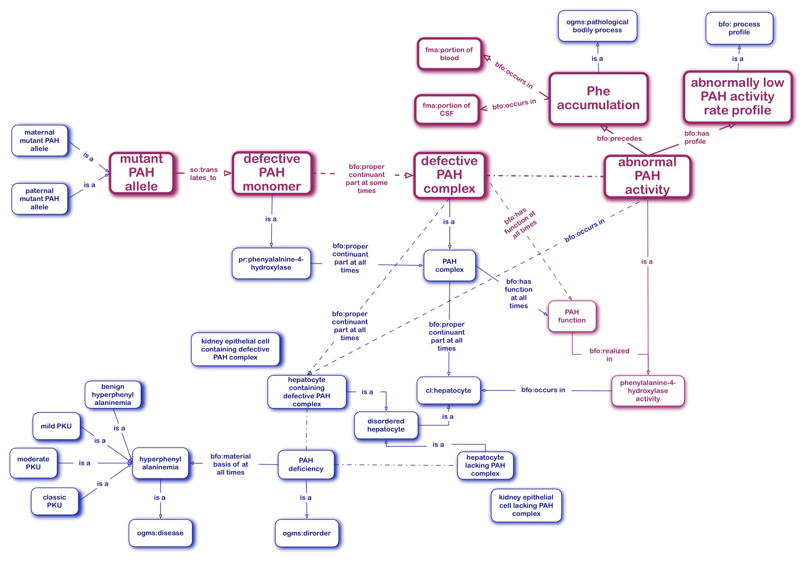
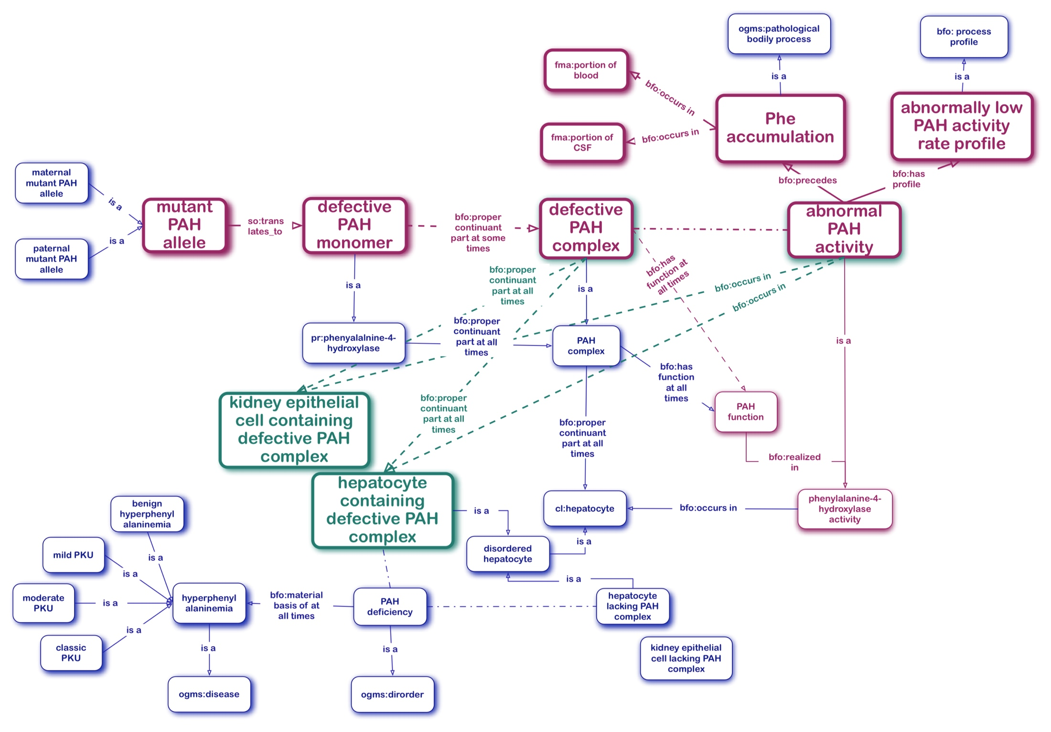
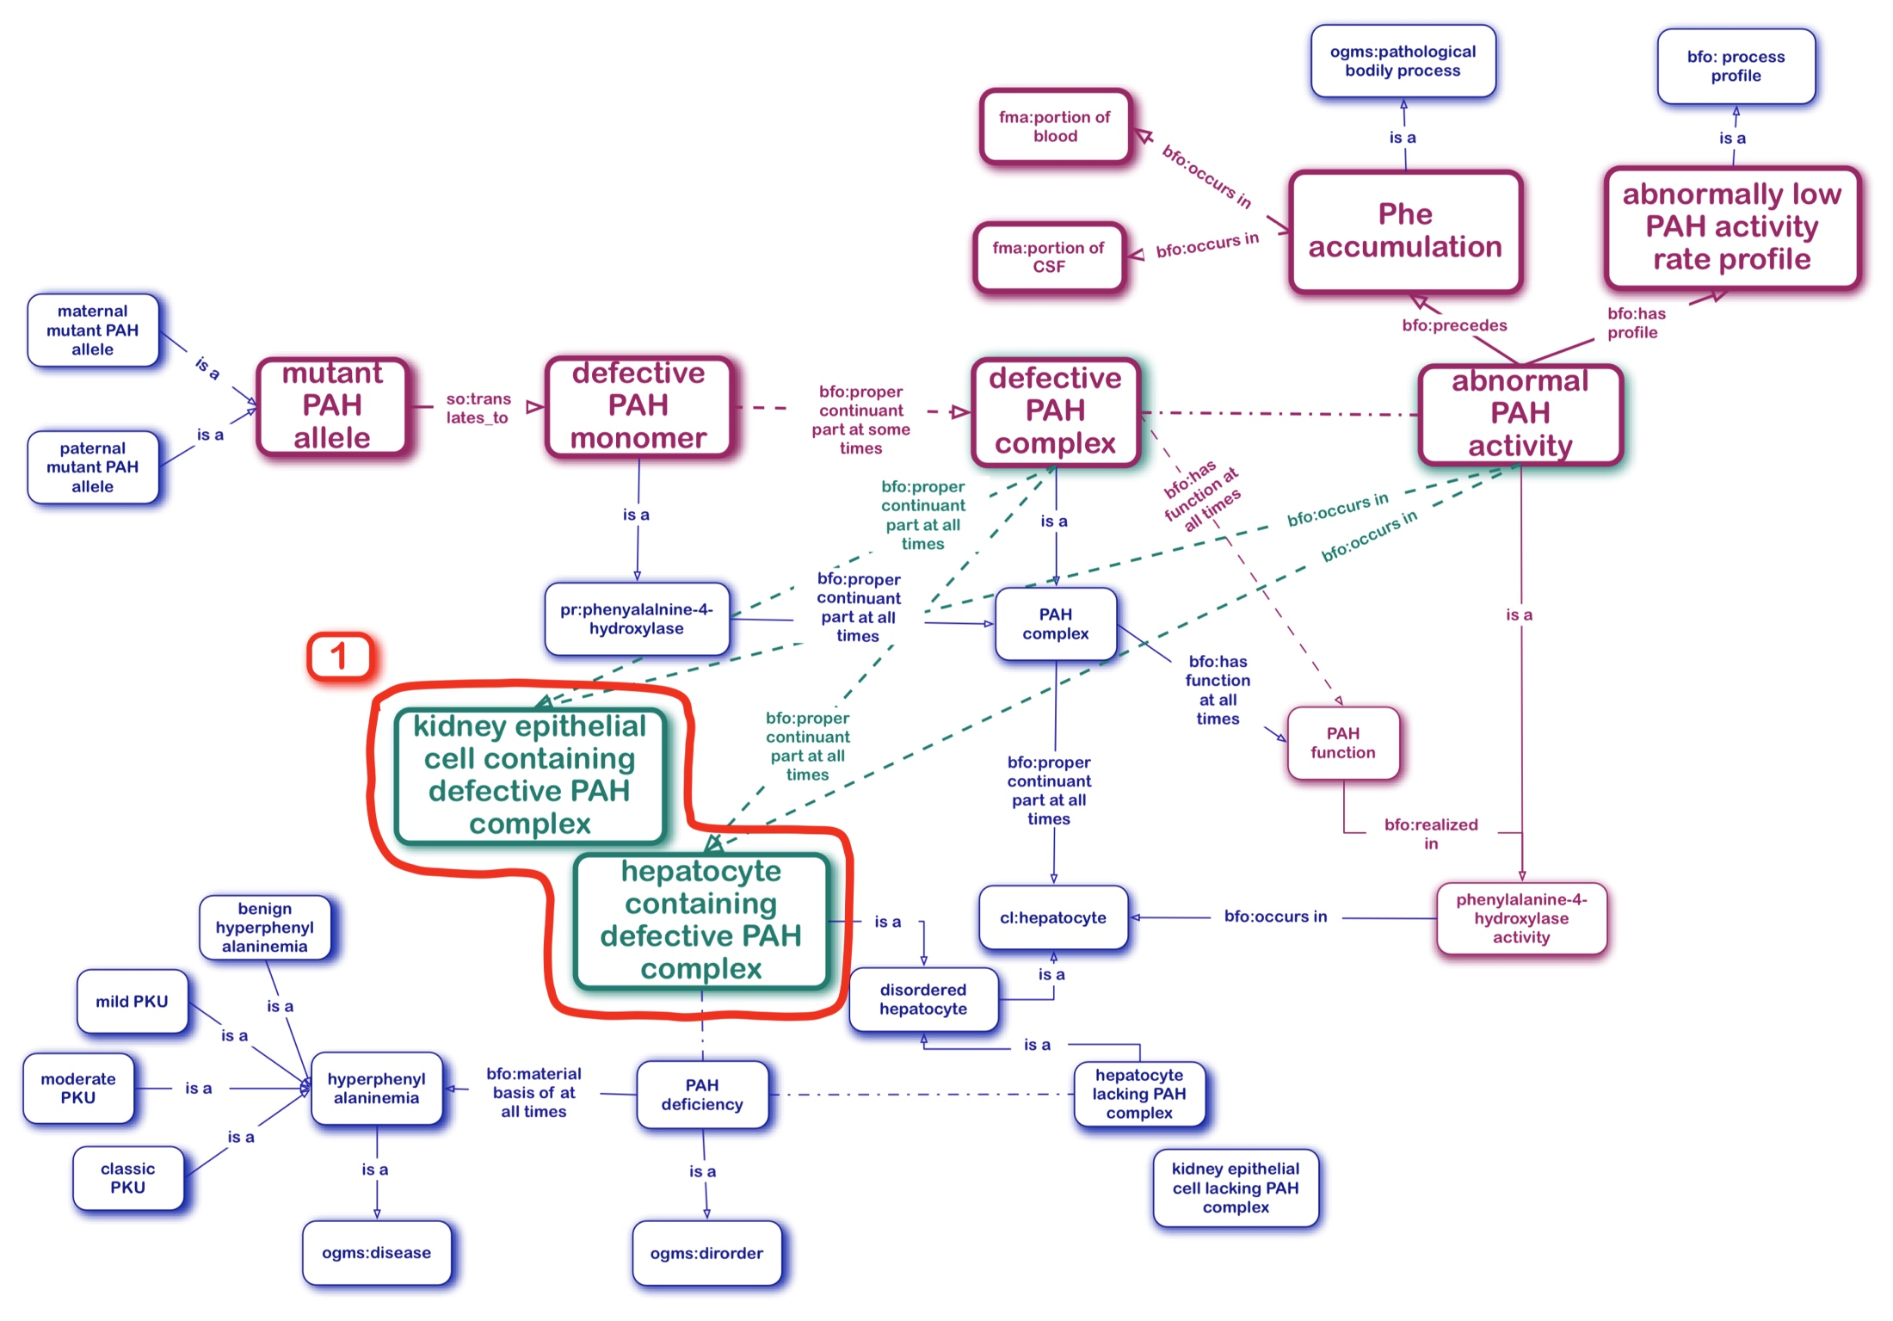
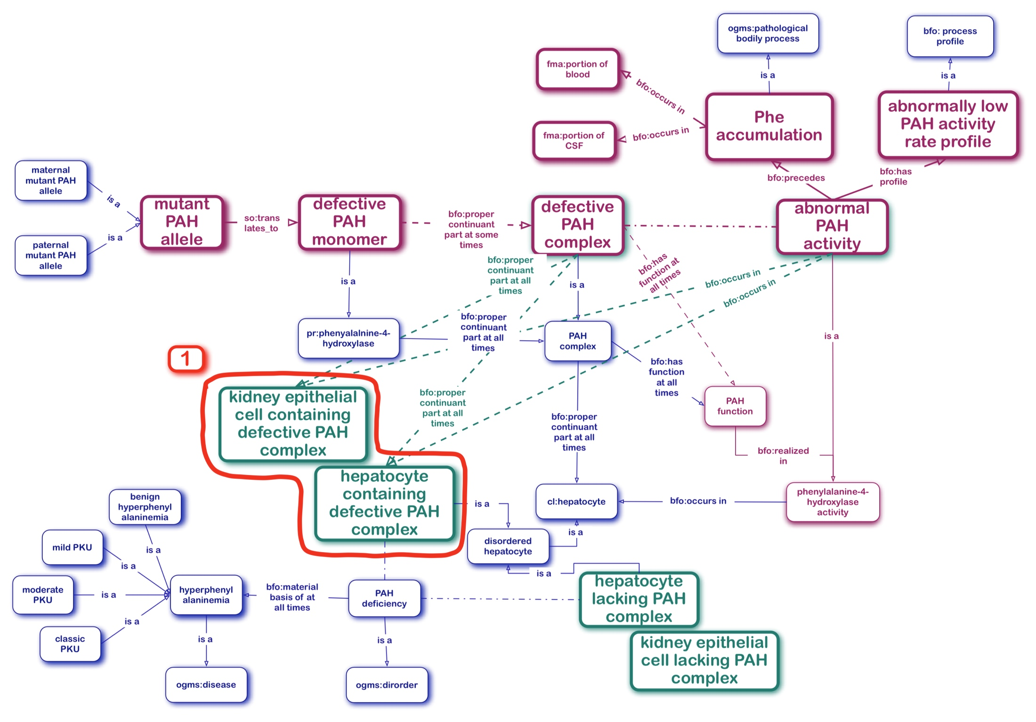
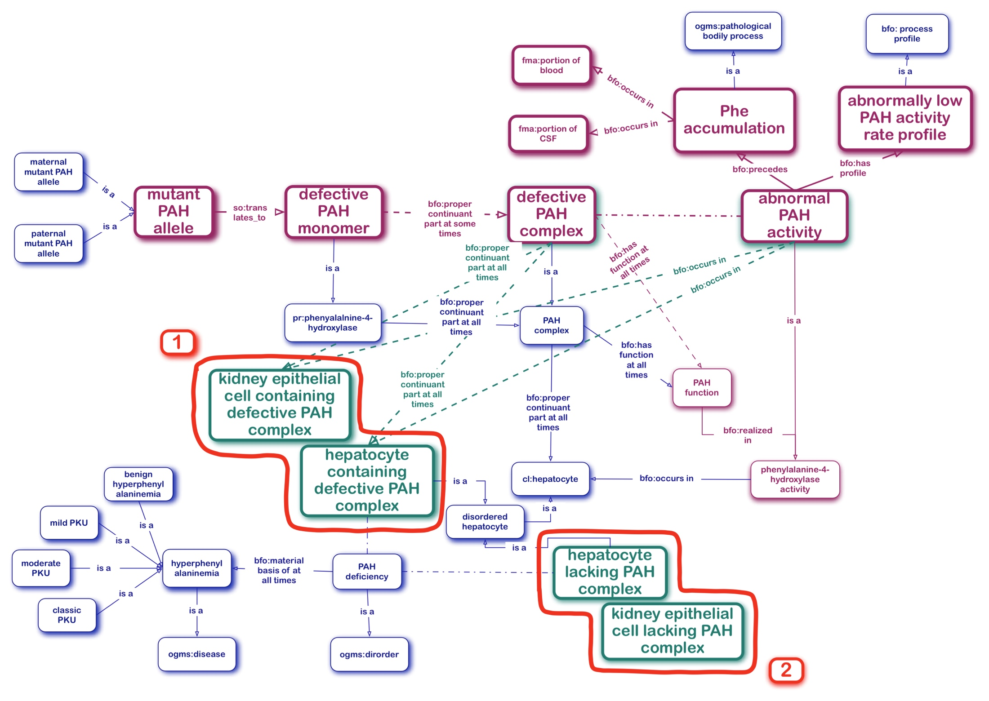
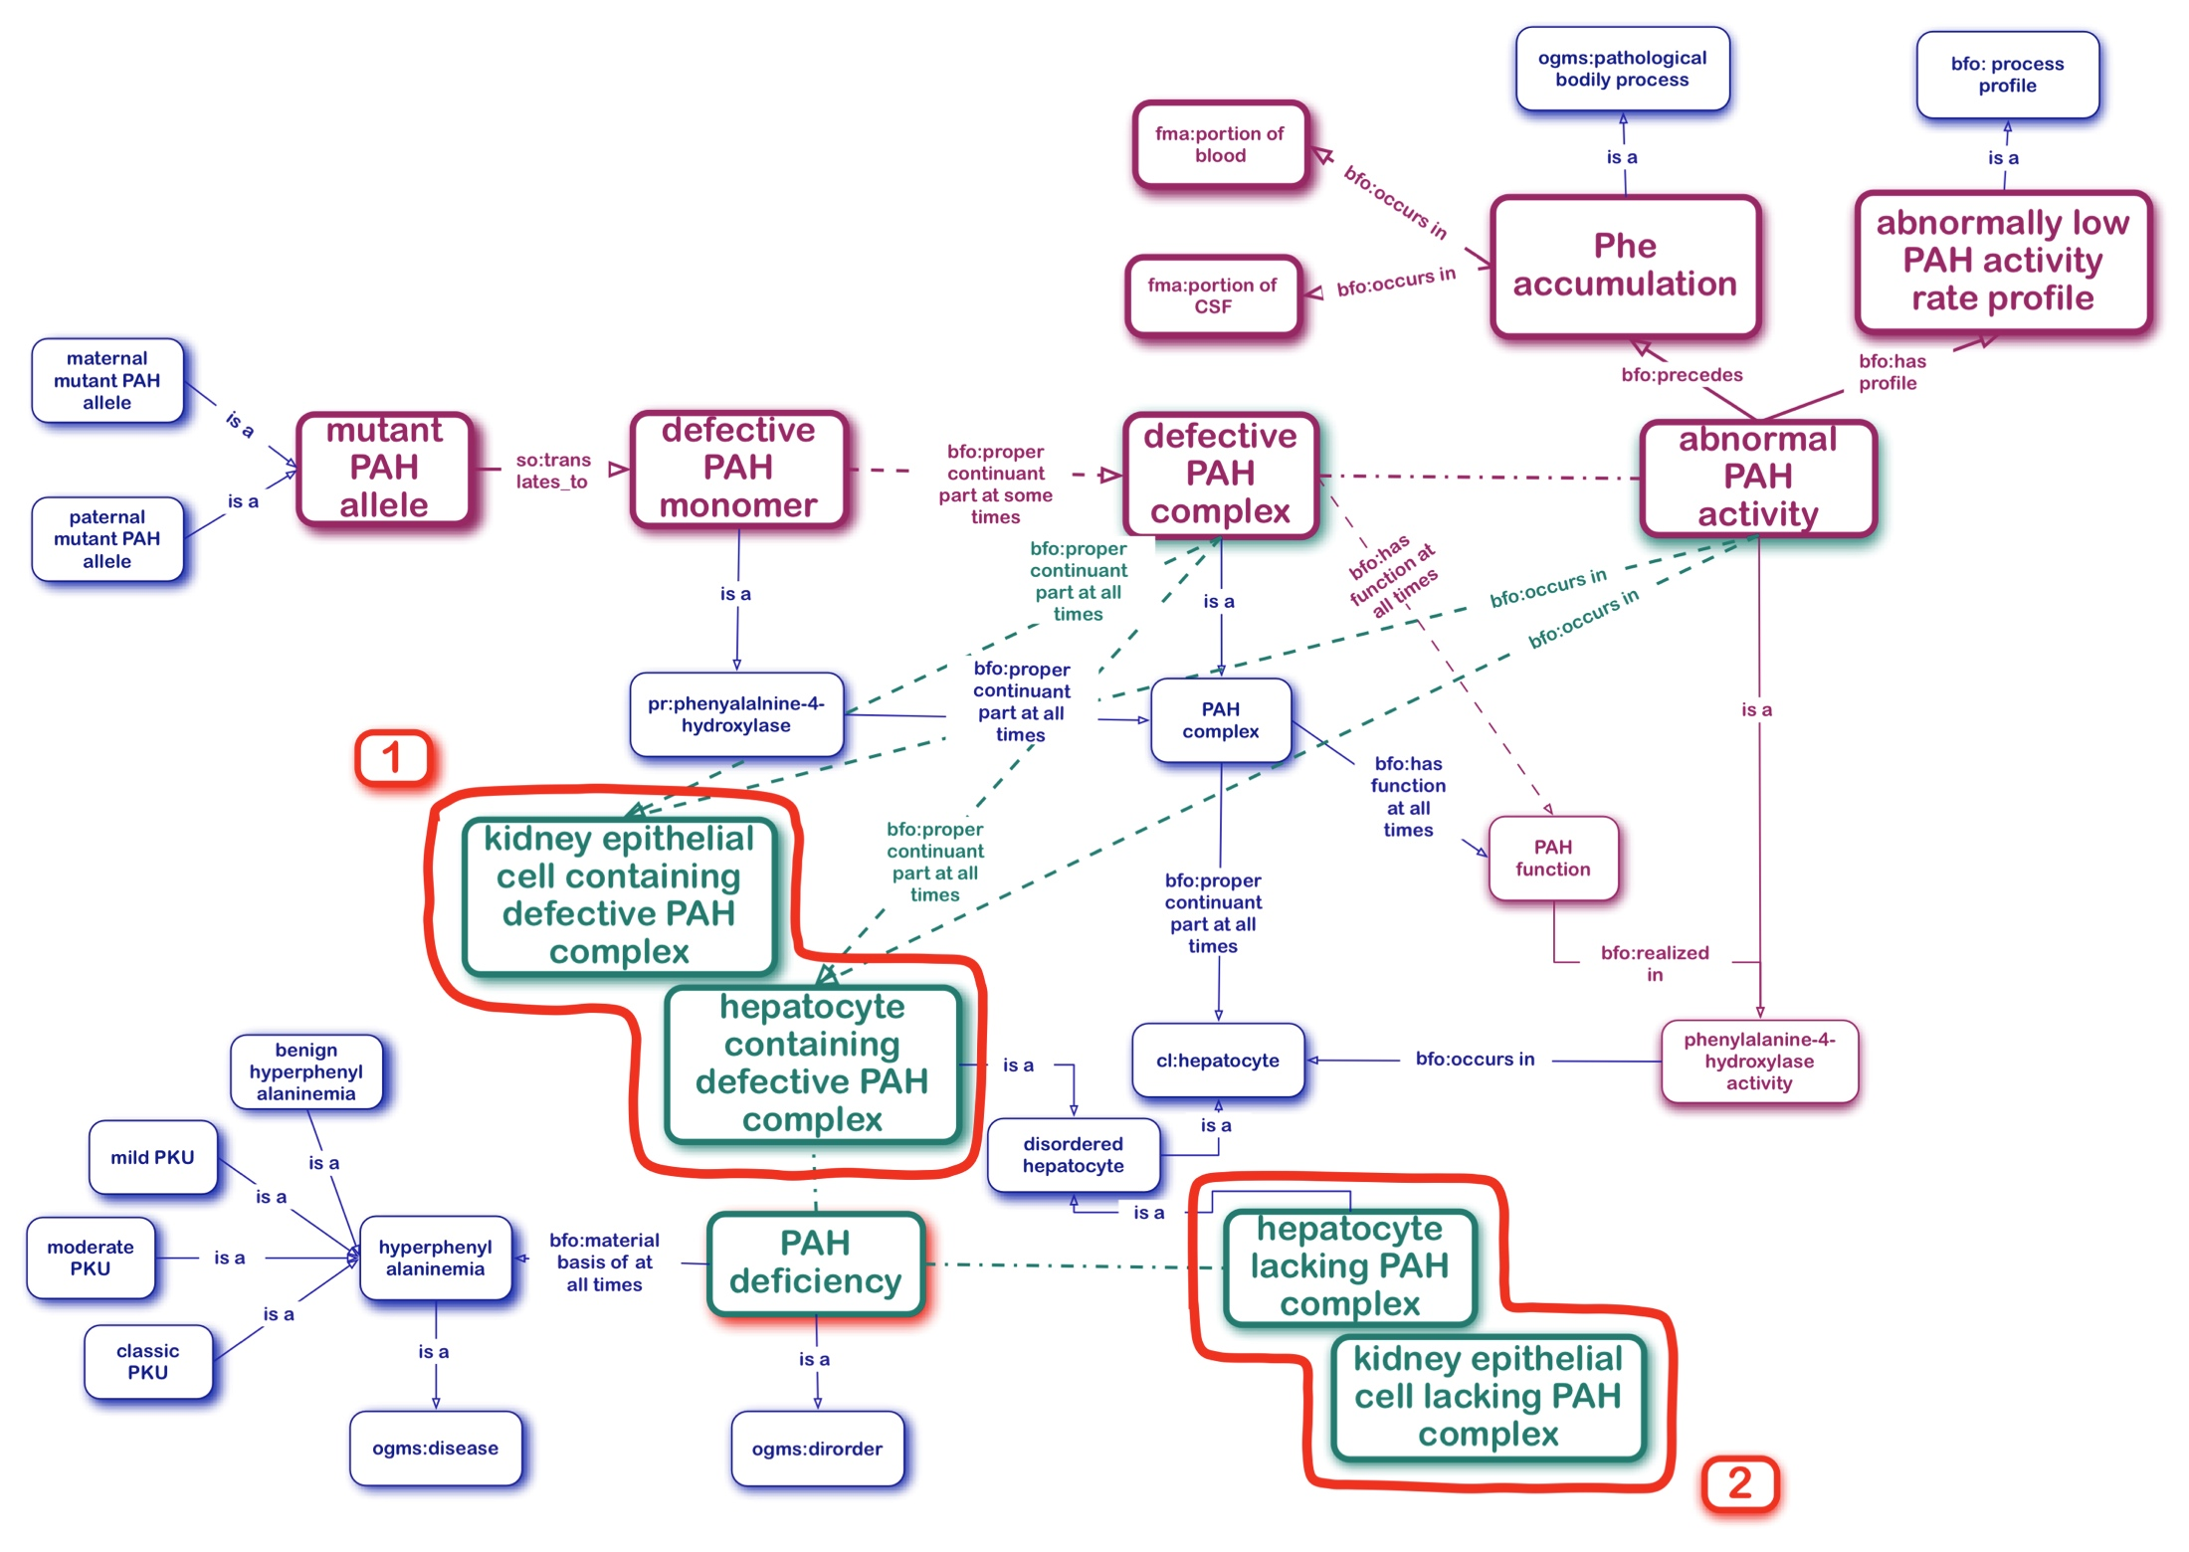
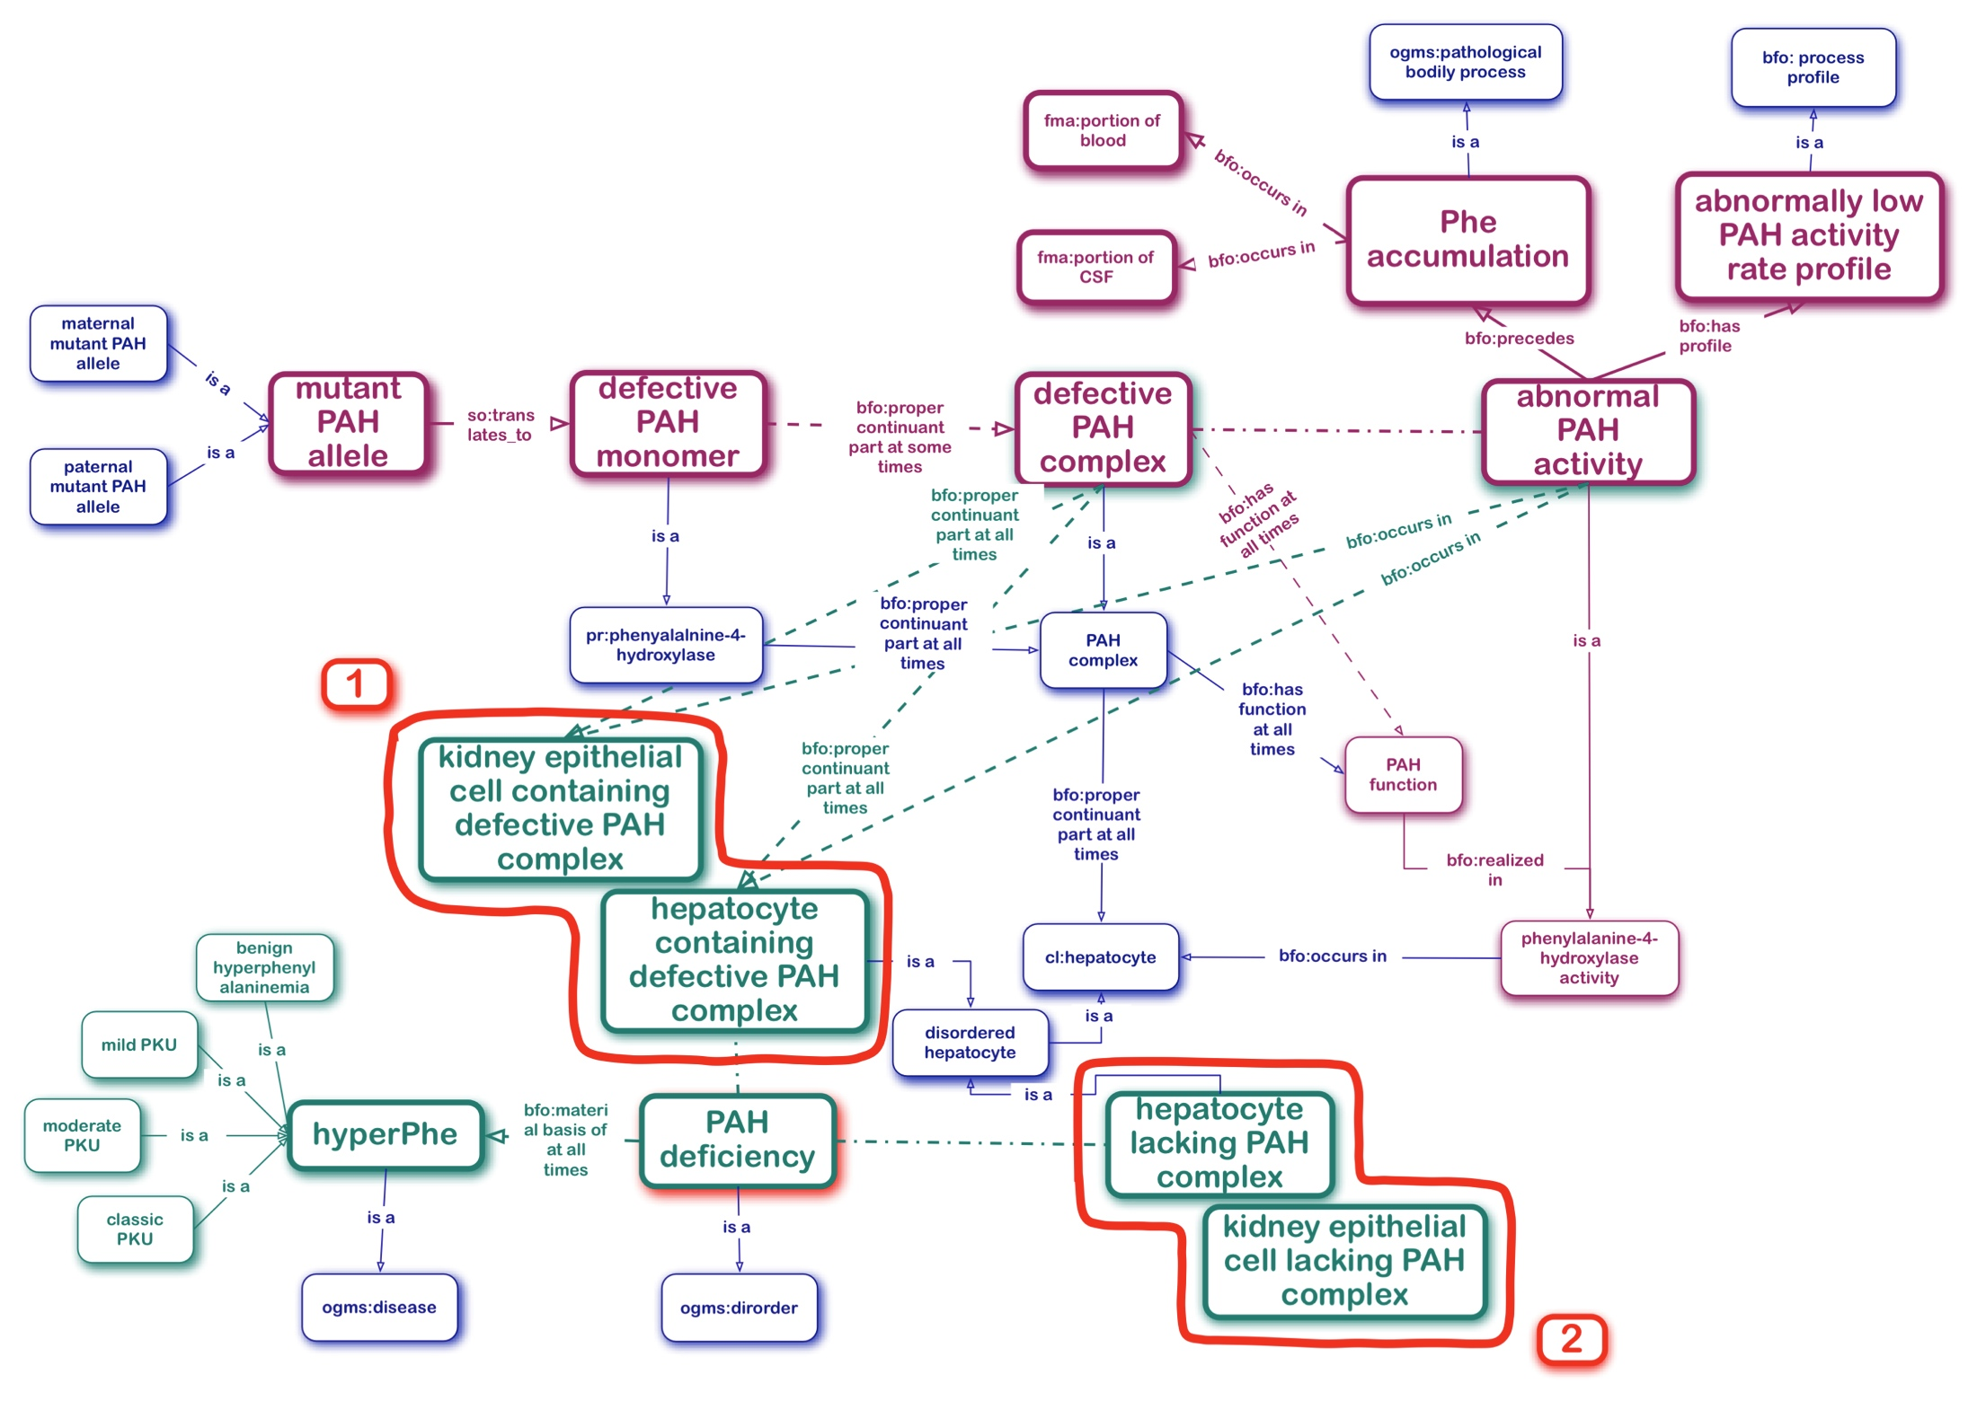
PAH Deficiency the Disorder and HyperPhe the Disease
OGMS
DISORDER =def. A material entity which is clinically abnormal
and a part of an extended organism.
Disorders are physical basis of disease.
DISEASE =def. A disposition
(i) to undergo pathological processes that
(ii) exists in an organism because of one or more disorders in that organism.
1
2

Slide 10
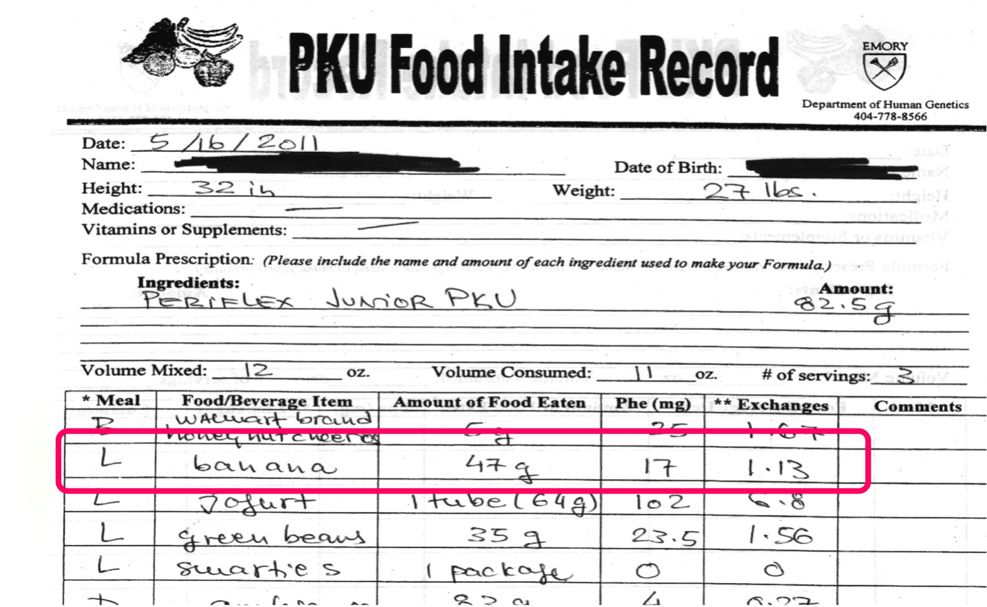
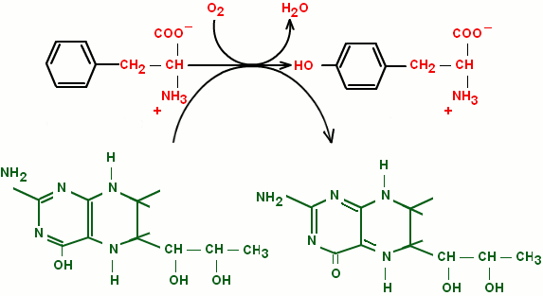
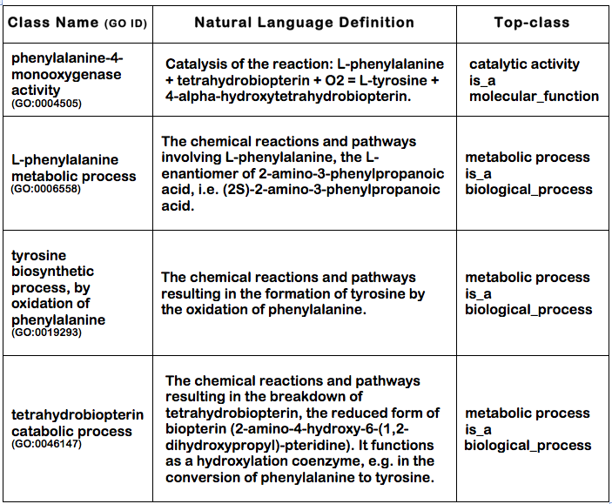
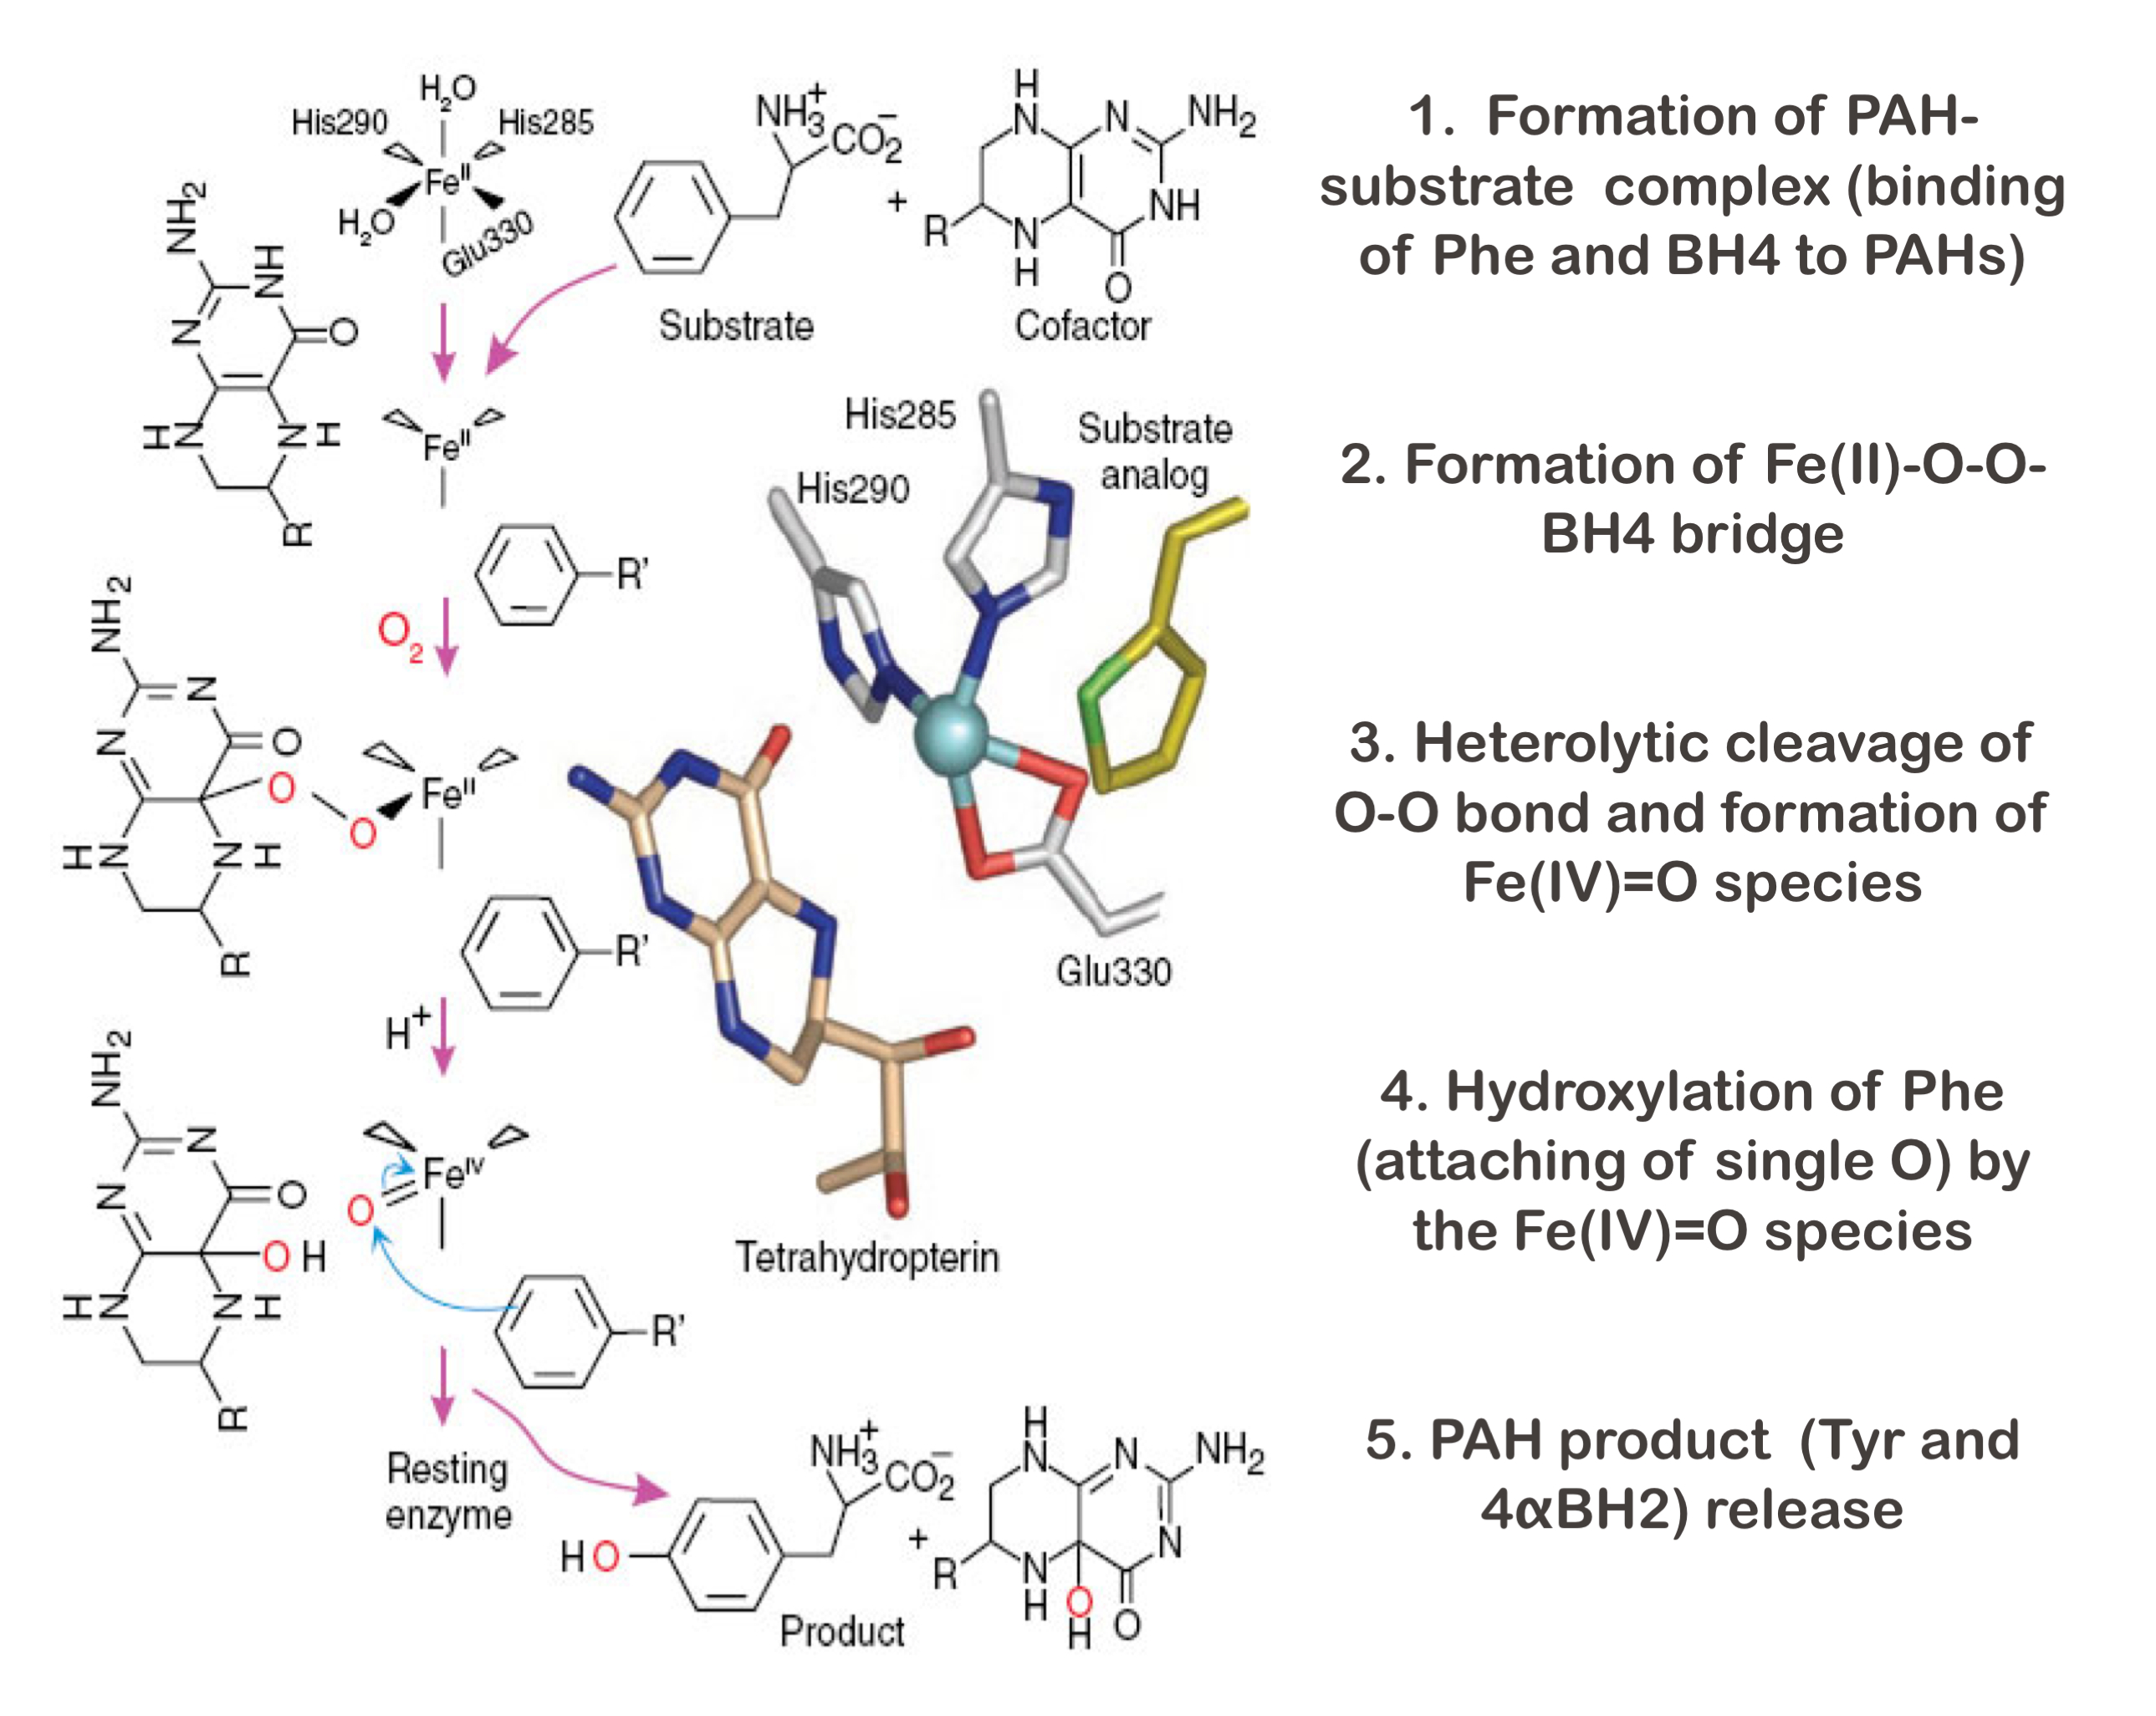
PAH Enzyme Activity Participants
- Why Bother?
Phe
•Dietary supplement/Therapy
•PAH enzyme product
•TAH enzyme substrate
Tyr
•PheOH/TyrOH/TrpOH enzyme product
•PCD enzyme substrate
BH4
4aOH-BH2
•SR/DHPR enzyme product
•PheOH/TyrOH/TrpOH enzyme cofactor
•Pharmacological chaperone (treatment option)
part_of

Slide 11
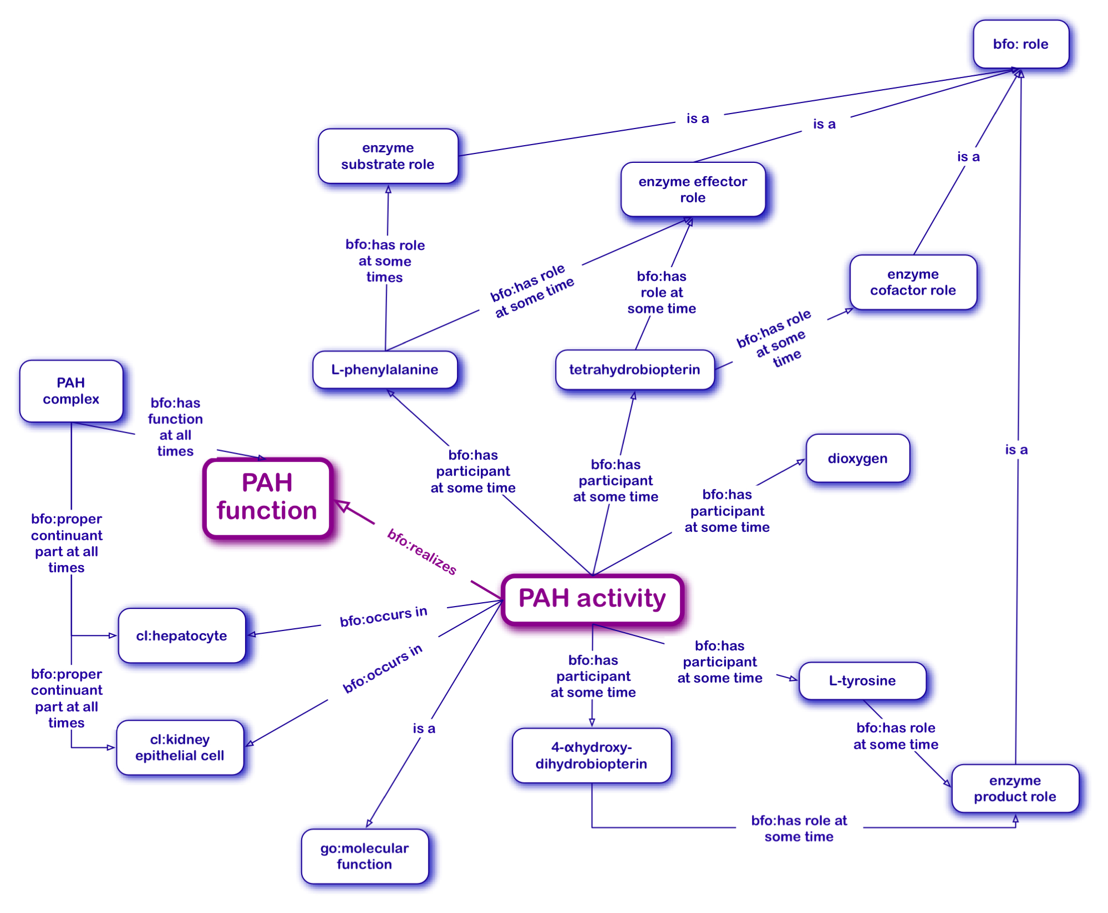
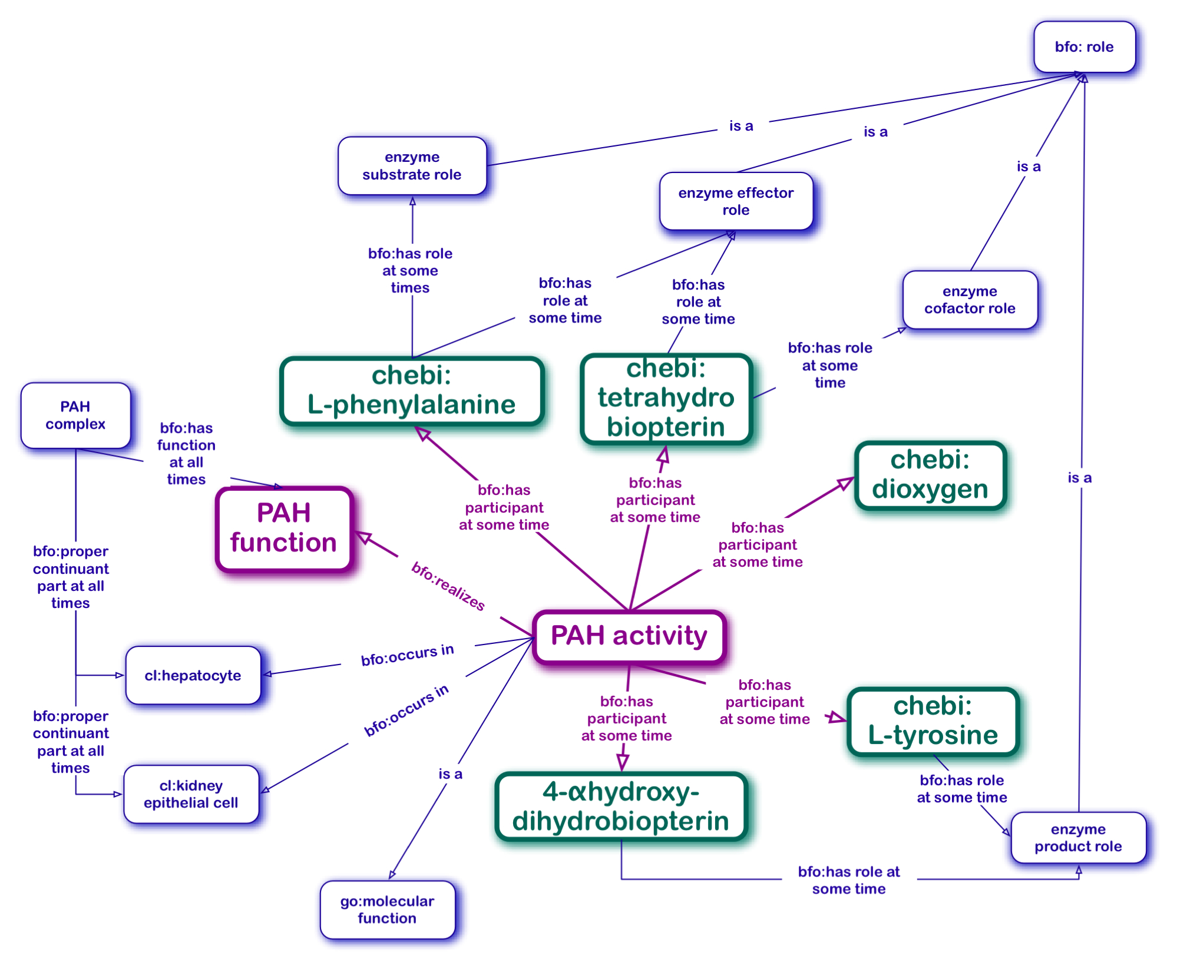
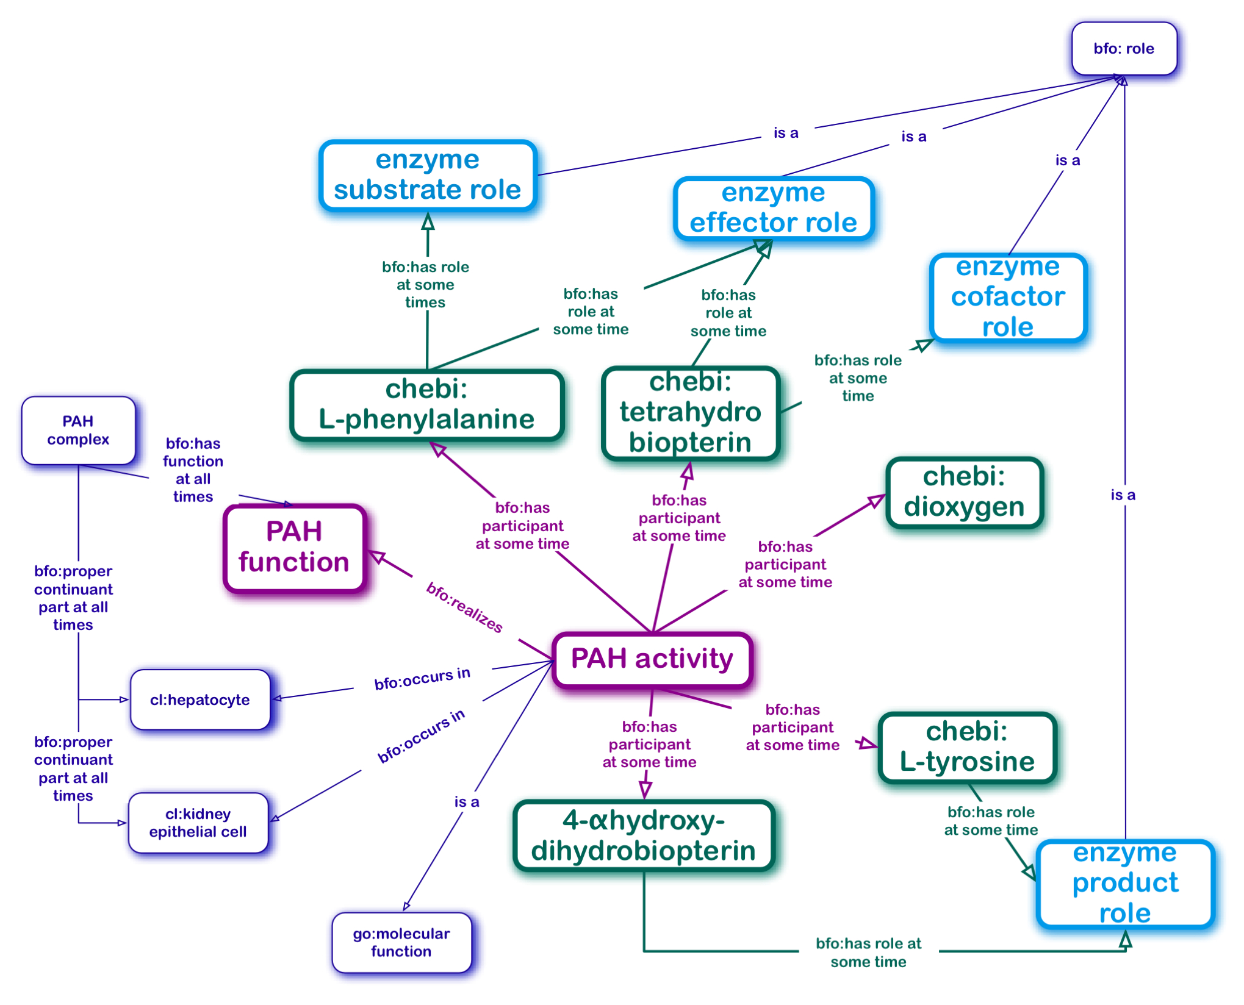
PAH Enzyme Activity Onto Model: Modified Situational Role Model
Enzymes are bearers of bfo:function
Phe
Tyr
PAH
BH4
4αOH-BH2
Other participants of enzymatic processes
are bearers of bfo:role

Slide 12
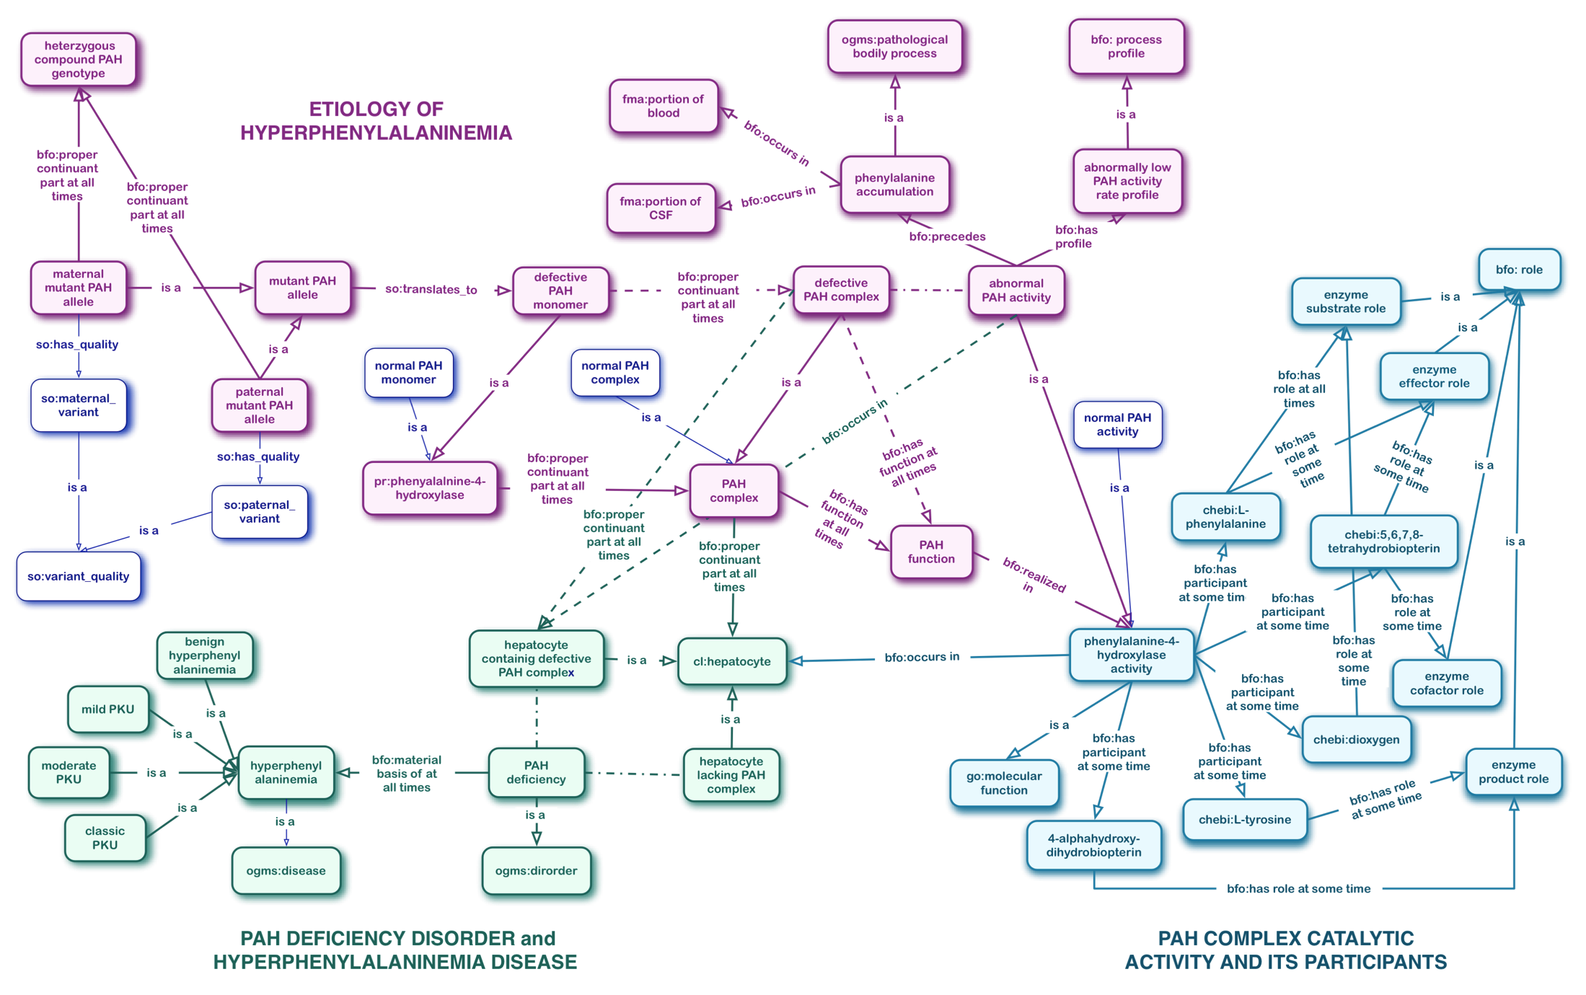
All Together Now: From Gene to Disease

Slide 13
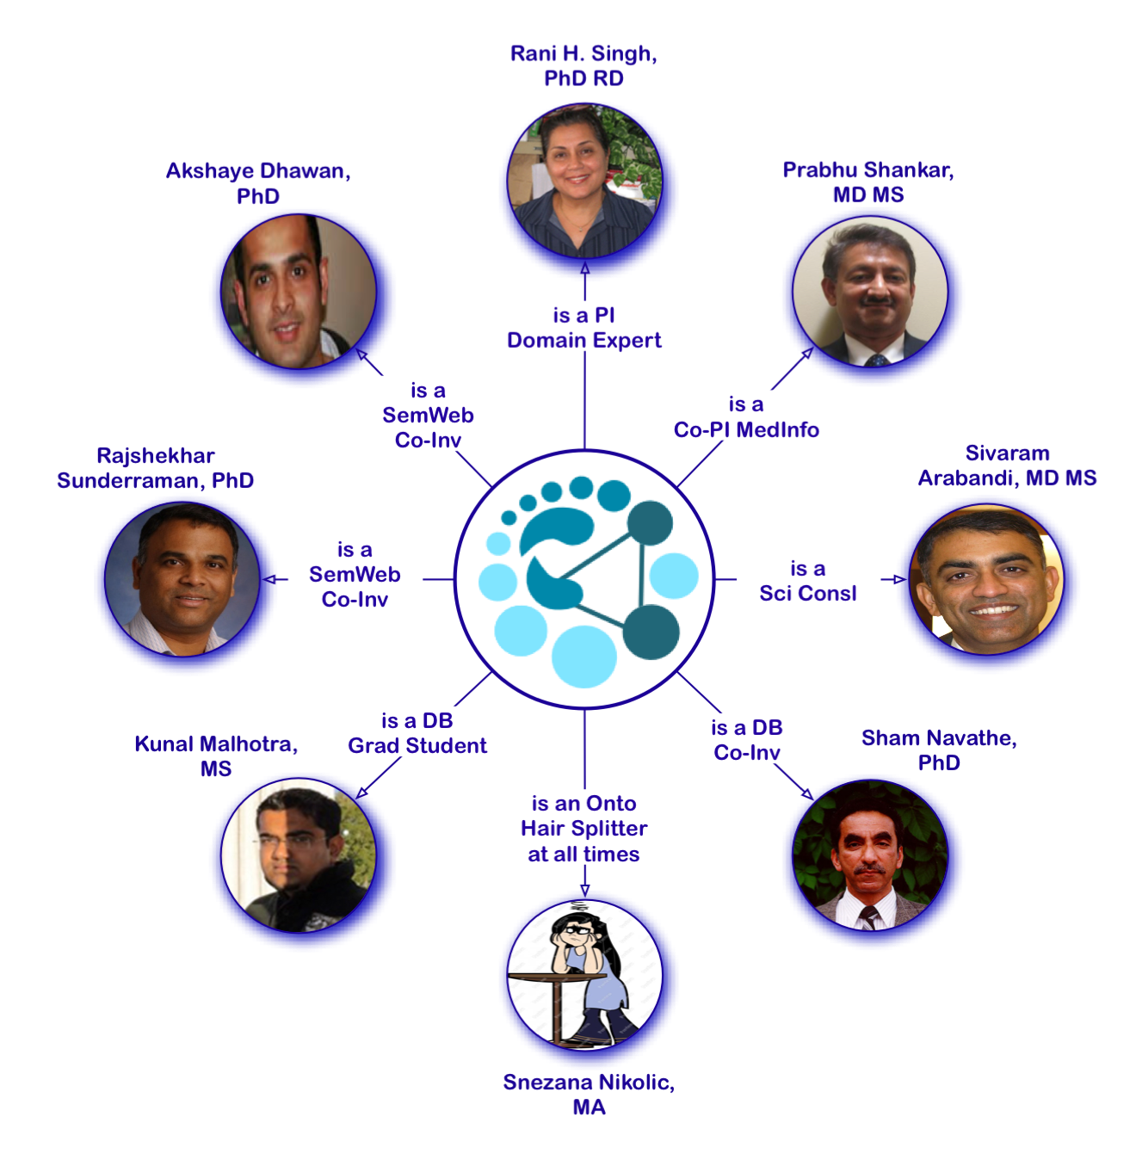
Acknowledgements
This work is partially supported by a 2009-10 HSI Seed Grant awarded by the Clinical Outcomes Research and Public Health (CORPH) Pilot Grants Program and by the Georgia Institute of Technology, the Children’s Healthcare of Atlanta and the Southeast NBS and Genetics Collaborative Grant awarded from the Maternal and Child Health Bureau,
HRSA Grant #U22MC10979.

Slide 14
Thank you!
https://nbsdc.org

